Slide 2
Applications of Computers and Programs
Engineering
Space Exploration
Natural Sciences
Bioinformatics
Cognitive and Brain Science
Art, Movies, Music
Medicine
Business
Sports
Knowledge

Slide 3
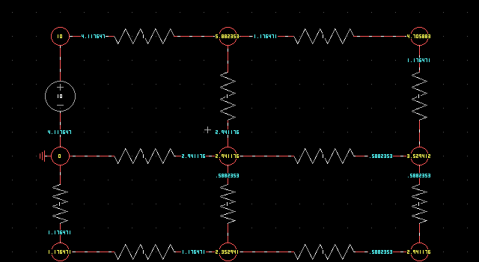
Engineering
Computing solutions to mathematically expressed problems
  Solving differential equations: understanding how the real world works and changes dynamically
  Finding solutions to non-liner equations and optimization problems
Simulation models of the physical world
  Carrying out experiments in the real-world can be expensive, slow & perilous
  Computer simulations of physical or chemical processes substitute and partially replace real experiments
  Pictured is the program Kcirc, which was written by a engineering student at Brown, and is now used to simulate electrical circuits in EN0052.

Slide 4
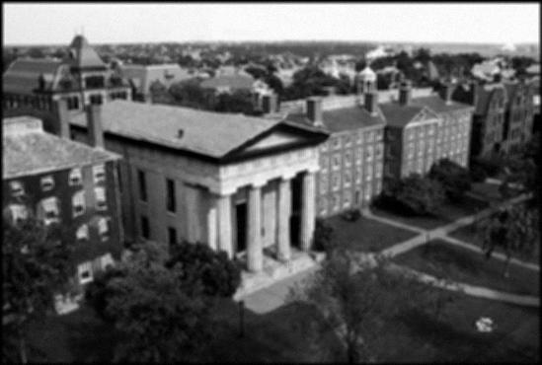
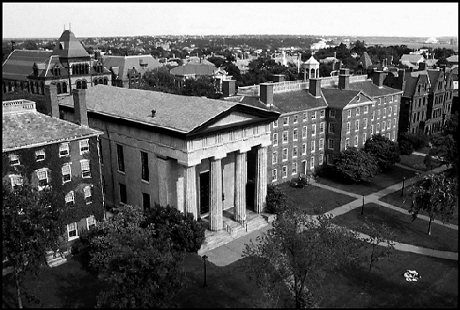
Engineering
Signal and image processing
  Managing and processing sensor data and measurements
  (e.g., filtering, restoring, compressing)
  In EN0157 students used C programming to do image de-blurring, some of their results are shown.

Slide 5
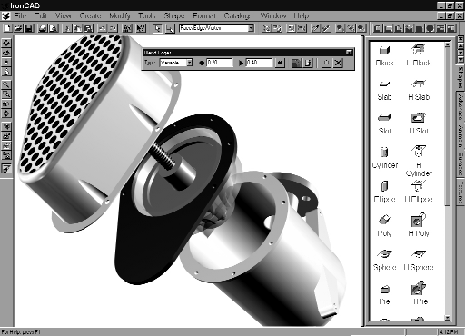
Engineering
Graphical tools (CAD)
  Design and improve mechanical parts, instruments & devices

Slide 6



Space Exploration

Slide 7
Natural Sciences
Physics & Astronomy
  Validation of theories by running computer simulations (everything from subatomic particles to the formation of galaxies)
  CERN: annually collects 1 PetaByte of data
    1,000,000,000,000,000
    P T G M K
  With the Large Hadron Collider 100PB are expected !!!
Chemistry
  Molecular design, 3D visualization of molecules
  Modeling chemical reactions, controlling & improving chemical processes
Aspirin

Slide 8
Bioinformatics
Cell biology and drug design
  Biochemical computer models of cells help to understand the principles of life
  Finding efficient ways of intervention for drug design
Human genome
  Processing and storage of data, creation of gene databases
  Functional genomics and proteomics: understanding how genes and proteins act and interact (large-scale computer simulations)

Slide 9
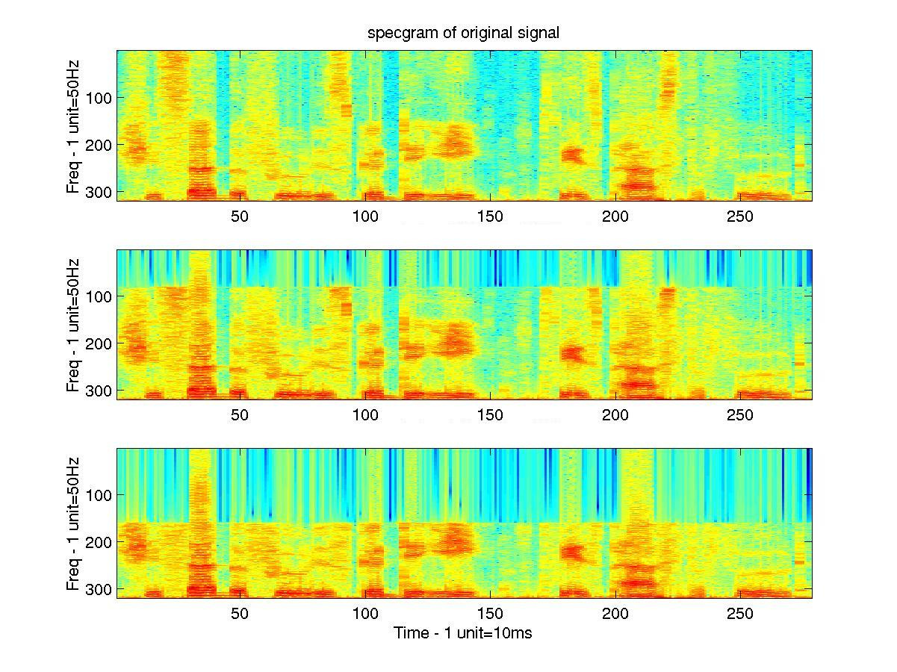
Cognitive and Brain Science
Understanding how humans process information
  What are the strategies used by the brain to process information (e.g., vision, language)?
  Computational models of perceptual & cognitive processes
  Spectrograms help the study of how we hear sound.
“The food is good to eat. Please pass the food.”

Slide 10

Cognitive and Brain Science
Computational models of the mind
  Biological substrate: brain, biological neural networks
  Understanding neural codes
  Interfacing humans & computers
  A past TA of CS4 did work on implanting chips into monkeys to allow them to directly control a computer cursor.
Monkey or TA?

Slide 11


Art, Movies, Music
New media to express artistic creativity
Movie making
  Computer graphics and animation everywhere
Games
  Just ask John Madden
Virtual Reality
Apple’s GarageBand
Trailer 1
Trailer 2

Slide 12

Medicine
Assistance in diagnosis
  Probabilistic expert systems to help doctors interpret findings
Signal processing
  Computers that process and visualize data from various devices (Xray, sonar, fMRI)
Enhanced reality and robotics
  Support new surgical procedures
Drug design

Slide 13
Business
E-commerce
  Buying on-line, software agents for shopping
  Trading between businesses (B2B)
Knowledge management
  Helping organize documents and tacit knowledge
Markets and banking

Slide 14
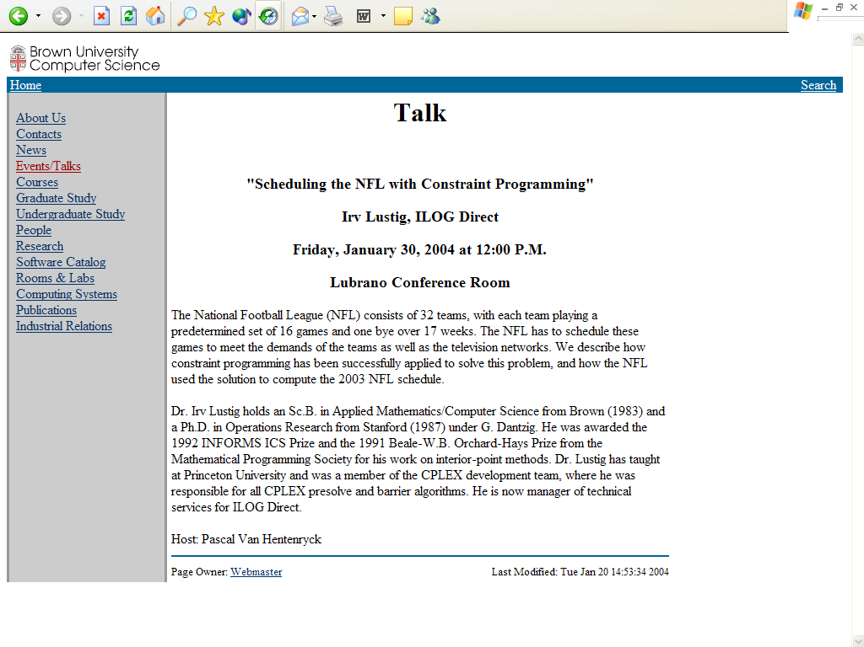
Sports

Slide 15

Knowledge
Search engines & digital libraries
  Archiving and disseminating information & knowledge
Intelligent Tools
  Finding interesting facts and new connections in scientific papers (text mining)
  Content-based access to information

Slide 16
Computer Programming
Computer programming in any language needs to address the following issues
  Design of algorithms & data structures:
    Goal: ensure efficiency and scalability
    An advance in algorithm design can result in faster programs than decades of chip design
  Implementation
    Actually typing the code into the computer!
Notes:
Franco Putzolu story on design.

Slide 17
Computer Programming (cont.)
  Program design (& software engineering):
    Having a good design for your program before you begin coding can save you hours of time fixing mistakes later.
  Debugging:
    More often than not your program won’t work the first time you try. Being able to figure out what is wrong is of critical importance.
Notes:
Franco Putzolu story on design.

Slide 18



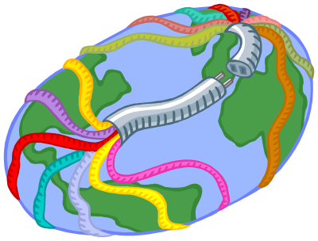
Computer Design
Central
Processing Unit
CPU
Main Memory
RAM

Slide 19
Programming Languages
Low Level
Low-level languages are specific to one type of computer (IBM, Macintosh, Sun SPARCstation, etc.). A machine language program for one machine typically cannot be run on a different type of machine.
The CPU defines an instruction set.
There are scores of CPU types: Pentium III, 8086, 6800, PowerPC, IBM 360, etc.

Slide 20
Programming Languages
Low Level
Programming languages can be classified according to how machine-specific or how “abstract” (high-level) they are.
Machine languages (lowest level)
  Each instruction is a sequence of 0s and 1s. (Almost) nobody programs at this level any more.
  Example
      1011 0000 0000 1000 0000 0000
      0110 0000 0000 0000 0010 0111

Slide 21
Programming Languages
Low Level
Assembler languages
  Simple instruction mnemonics and symbolic references to memory (names)
  Example
      MOV AL,8
      ADD [200],AL

Slide 22

Pentium® Instruction Set

Slide 23

Pentium® Instruction Set
Notes:
683 instructions

Slide 24
Programming Languages
High Level
Most programs are written in high level languages.
Examples
  Procedural languages: C, Pascal, Fortran
  Object-oriented languages: C++ and Java
  Many more: Algol, Modula2, Lisp, Prolog, Ada, Scheme, Simulink, Oberon, etc.

Slide 25
Programming Languages
High Level
A program written in a high-level language can generally be run on a variety of machines, such as a PC, Macintosh or SPARCstation.
However, the computer hardware only understands machine language programs. So how can a computer understand a high-level language when it can only deal with 1s and 0s?

Slide 26
Compilers and Interpreters
Compilers and interpreters translate high-level languages, such as C, into machine language (they are programs themselves!).
example
example.exe
example.c
example.o
gcc
(C compiler)
ln
(linker)
source file
object file
executable file
other library files

Slide 27
Compilers and Interpreters (cont.)
Interpreters translate statement by statement at runtime.
Compilers produce more efficient code by translating the program as a whole in advance.

