Slide 1



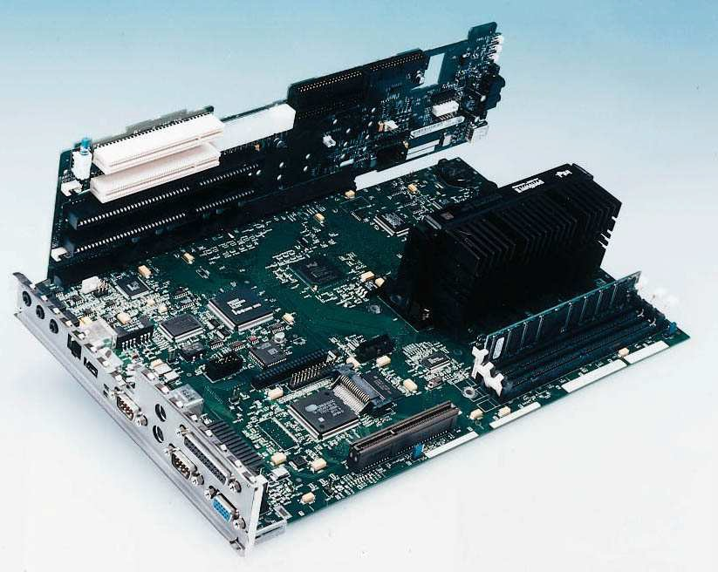
Lecture 7
Computer Componets and Peripherials

Slide 2
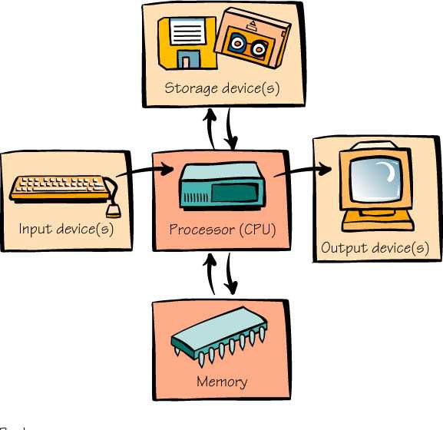
What Computers Do
Four basic functions of computers include:
Receive input
Process information
Produce output
Store information

Slide 3
Input Devices
Computers accept information from the outside world.
The keyboard is the most common input device.
Pointing devices like the mouse also receive input.

Slide 4
Process Information
The processor, or central processing unit (CPU), processes information, and performs all the necessary arithmetic calculations. The CPU is like the “brain” of the computer.

Slide 5

Output Devices
Computers produce information and send it to the outside world.
A video monitor is a common output device.
Printers also produce output.

Slide 6
Store Information
Memory and storage devices are used to store information.
Primary storage is the computer’s main memory.
Secondary storage uses disks or other media.
Primary storage
Secondary storage

Slide 7
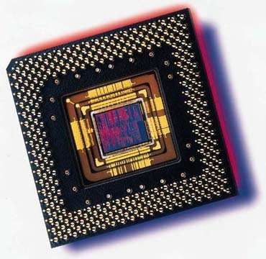
The Computer’s Core: The CPU and Memory
The transformations are performed by the CPU - the central processing unit or processor.
The microprocessor, which is a silicon chip, is located on the motherboard.

Slide 8
The Computer’s Core: The CPU and Memory
When you purchase a computer, the selection of the CPU is a very important choice. There are two factors that are very important to computer users are:
Compatibility
Speed

Slide 9
Compatibility
Not all software is compatible with any given CPU. Each computer has a unique instruction set - a vocabulary of instructions the processor can execute.
New microprocessors can usually run older software, but new software is not usually compatible with old microprocessors.

Slide 10




Speed
The computer’s speed is measured by the speed of its internal clock - a device to synchronize the electric pulses.
Speed is measured in units called
megahertz (mHz).

Slide 11
Primary Storage: The Computer’s Memory
RAM (random access memory):
is the most common type of primary storage, or computer memory.
used to store program instructions and data temporarily
unique addresses and can store in any location
can quickly retrieve information
will not remain if power goes off (volatile).

Slide 12
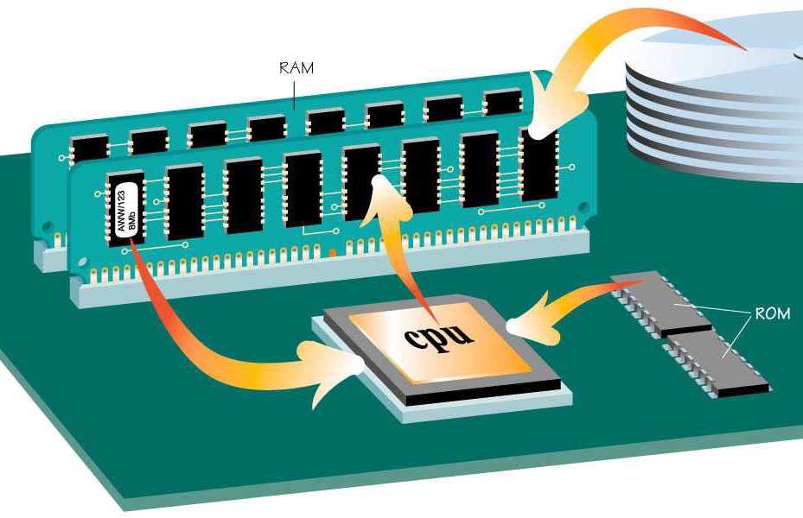
Primary Storage: The Computer’s Memory
ROM (read-only memory):
  information is stored permanently on a chip.
  contains startup instructions and other permanent data.

Slide 13
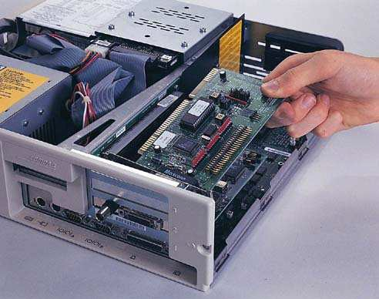
Buses, Ports, and Peripherals
Information travels between components through groups of wires called buses.

Slide 14
Buses, Ports, and Peripherals
Peripherals:
are external devices for receiving input or producing output (keyboard, monitor, and mouse).
communicate with other parts of the system.

Slide 15
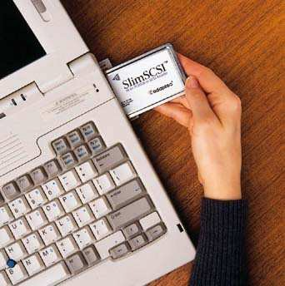
Buses, Ports, and Peripherals
– provide attachment and communication with external devices by means of:
slots (for internal attachment)
ports (for external attachments)

Slide 16
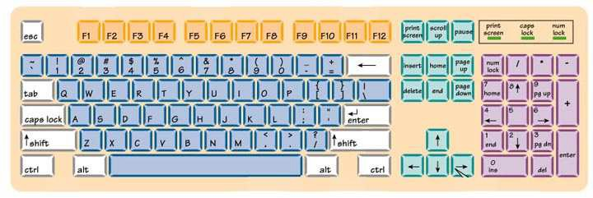
The Omnipresent Keyboard
Do you know where these keys are located on the keyboard and how to use them?
Letters, Numbers, Cursor Keys, Delete Key, Enter
(Return) Key, and Function Keys

Slide 17

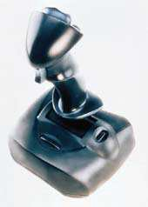
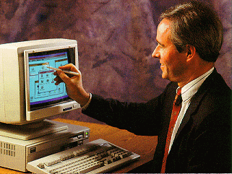
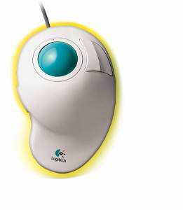
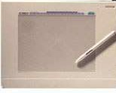
Pointing Devices
Mouse
Joystick
Touch Screen
Graphics Tablet
Trackball

Slide 18
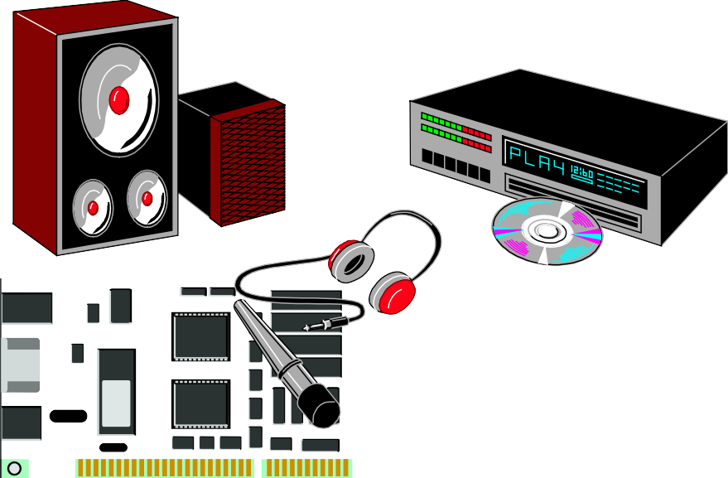

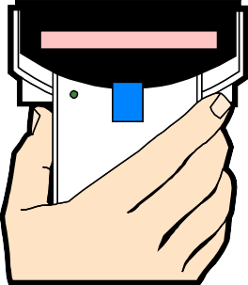

Digitizing the Real World
Video digitizing
Hand-held Scanner
Audio digitizing
Flatbed Scanner

Slide 19
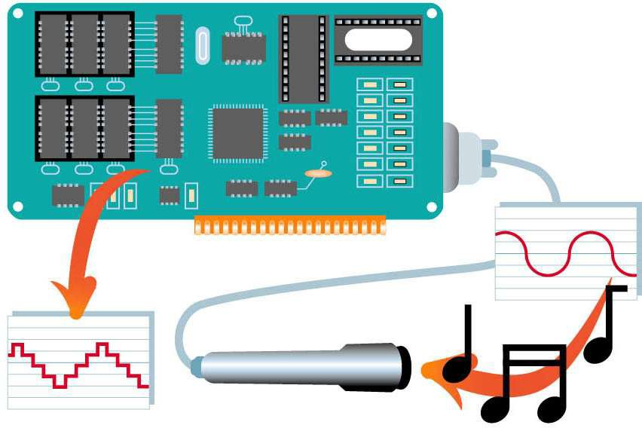
Audio Digitizers
Audio digitizers contain circuitry to digitize sounds from microphones and other audio devices.

Slide 20



Video Digitizers
Video digitizers contain circuitry to digitize frames from camcorders and other video sources.

Slide 21
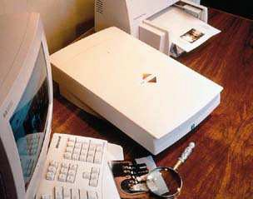
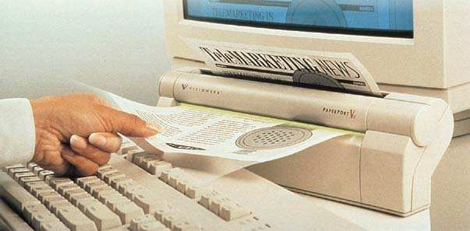
Scanners
Scanners capture and digitize images from external paper sources.

Slide 22

Output: From Pulses to People
Paper
Video Monitor
Sound
Controlling Other Machines

Slide 23
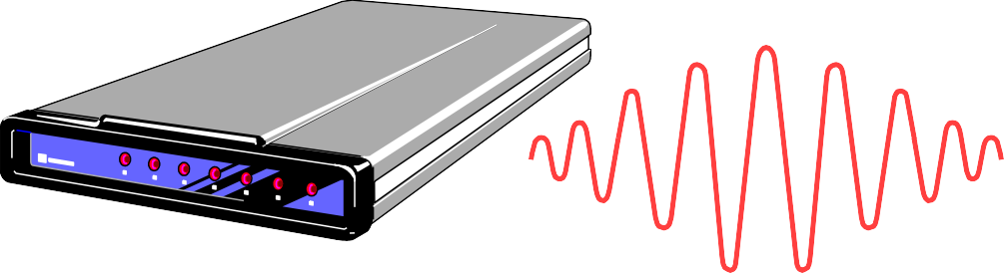
Communication á la Modem
A modem:
– Converts the digital stream of information from a computer to an analog stream in order to send a message on the telephone network

Slide 24
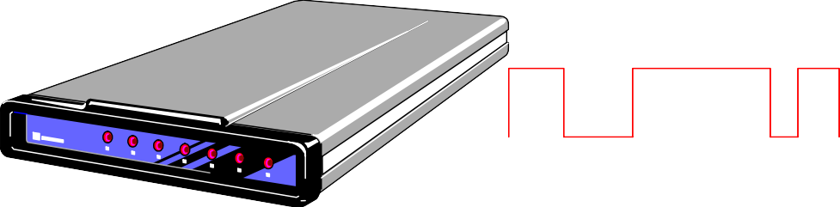
Communication á la Modem
A modem:
– Converts the analog stream of information received over the telephone network into the digital form that the computer understands

Slide 25






















How a Modem Works
The word modem comes from the terms modulation and demodulation
Modulation
Analog
Phone line
Demodulation
Digital signals
signals
Digital signals
Modem
Terminal
Modem
Computer

Slide 26
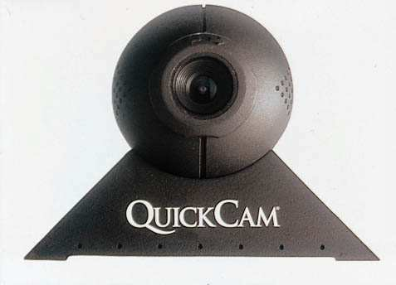
Digital Cameras
Digital cameras turn real-world scenes into digital images that can be stored and manipulated by the computer.
The images, stored in memory, can be transferred to a computer for either editing or storage.

Slide 27
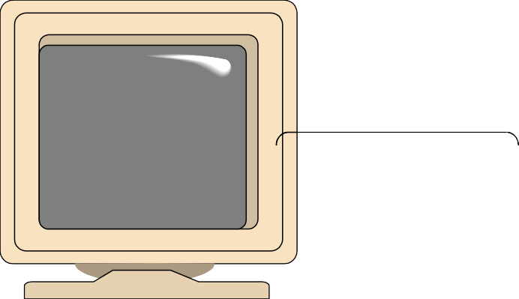
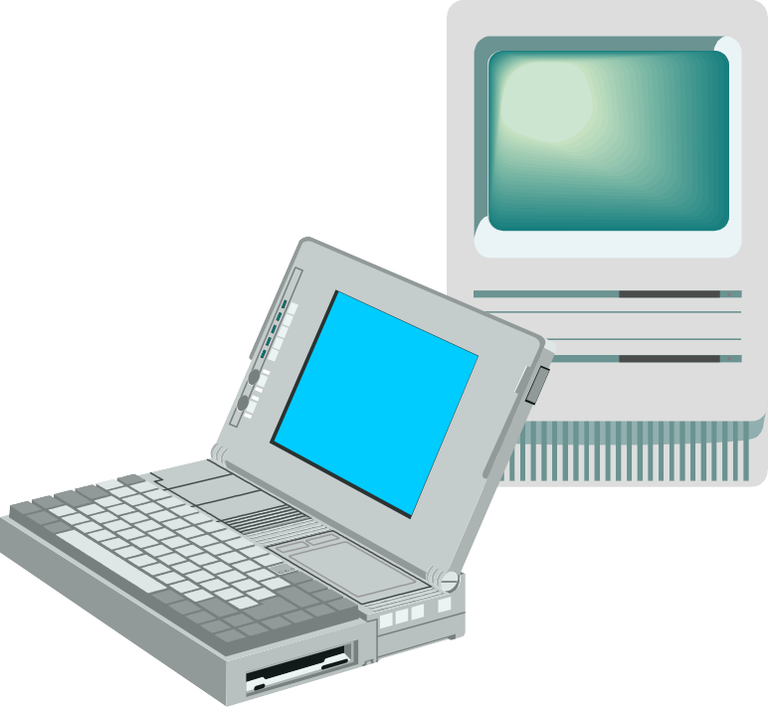
Screen Output
Video Monitor
  Also called Video Display Terminal (VDT)
  Image exists in video memory—VRAM
  Monitor size is measured diagonally across the screen

Slide 28
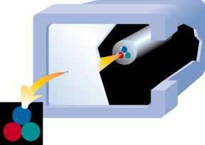
Pixels
Images are made up of dots called pixels for picture elements
The number of pixels affects the resolution of the monitor
The higher the resolution, the better the image quality

Slide 29

Classes of Monitors
CRT (cathode ray tube)
LCD (liquid crystal display)

Slide 30
CRT (Cathode Ray Tube)
A CRT is a television-style monitor
Its features include:
  Clear image
  Quick response time
  Low cost
  Very popular

Slide 31
LCD (Liquid Crystal Display)
LCDs comprise flat-panel monitors
Features of flat-panel monitors include:
  Lighter weight
  More compact
  More expensive
  Dominate the portable computer market

Slide 32
Paper Output
Paper output is sometimes called hard copy
Hard copy can come from one of two kinds of printers:
  Impact printers
  Nonimpact printers

Slide 33
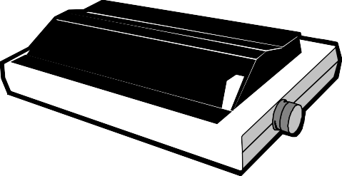
Impact Printers
Line printers
  Used by mainframes for massive jobs
  Limited characters available
Dot-matrix printers
  Image formed from dots printed on paper
  Good for text and graphics
  Inexpensive

Slide 34
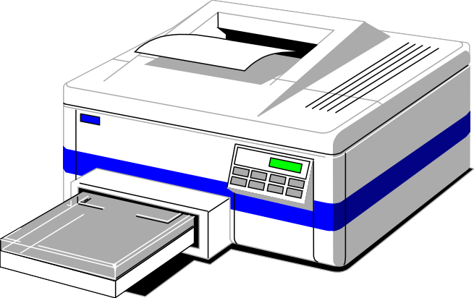
Nonimpact Printers
Laser printers
  Image transferred to paper with laser beam
  Faster and more expensive than dot-matrix
  High-resolution hard copy

Slide 35

Other Nonimpact Printers
Ink-jet
  Dots of ink are sprayed onto the paper to form the image
  High-resolution hard copy
  Some models print can print color photographs

Slide 36


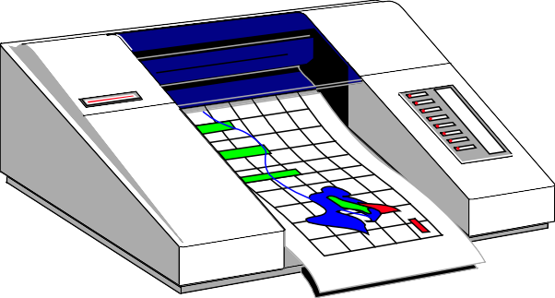





Other Nonimpact Printers
Plotters
  Image transferred to paper with ink pens
  Very high resolution
  Excellent for scientific and engineering applications

Slide 37

Secondary Storage: Input and Output
Peripherals with both input and output functions. This form of storage is semi- permanent
Examples include:
  Magnetic tape
  Magnetic disks
  Optical disks

Slide 38
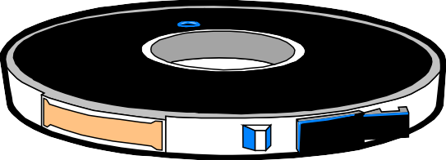
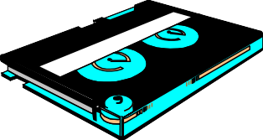
Magnetic Tape
Magnetic tape is a common form of storage for mainframe computers.
Information is accessed sequentially
Massive storage for low cost but retrieval is slow
DAT (digital audio tape) is preferred for storage on small computers

Slide 39

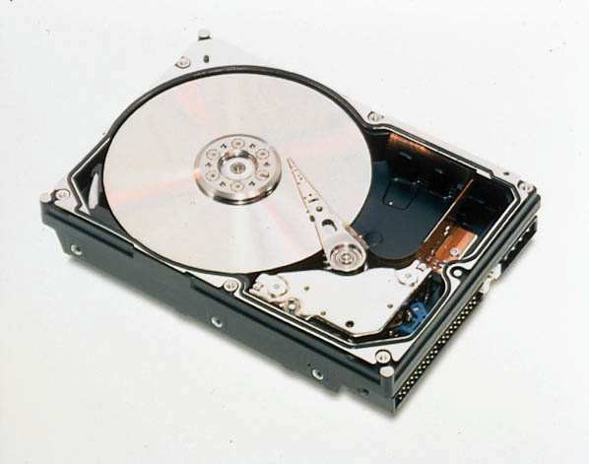
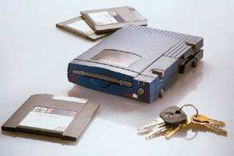
Magnetic Disks
Floppy Disk
Hard Disk
Zip Disks and Zip Drive

Slide 40
Hard Disks
Hard disks are:
  Rigid, magnetically sensitive metal disks.
  Designed so that information can be randomly accessed
  Designed for large storage capacity
  Able to access data quickly
  Not removable from the drive

Slide 41
Diskettes
Diskettes are:
  Flexible, magnetically sensitive plastic disks
  Information can be randomly accessed.
  Has limited storage capacity
  Access of data not as quick as hard disks
  Removable from the drive

Slide 42
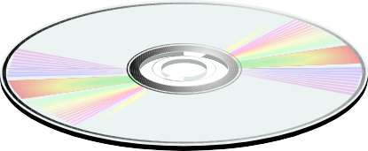
Optical Disks
CD-ROM and magneto-optical disks provide:
  Random access of information
  A high storage capacity
CD-ROM and magneto-optical disks:
  Have an access time that varies but is slower than hard disks
  Are removable from the drive

Slide 43
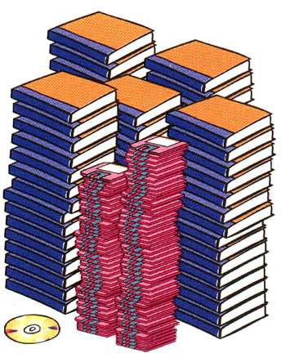
Storage Capacity
A single CD-ROM can hold as much information as
450 1440K diskettes
500 books (text only)

Slide 44
Consumer View
There is an ad in a newspaper selling a computer of the following configuration:
Intel PII 450 MHz, 128 RAM, HDD 6.4 GB, 512 KB L2 cache, 24X Acer CD-ROM, CD- RW, 4MB 3D Video Card, Motorola 56k V.90 PCI Modem Data/Fax/Voice, 4 PCI and 2 ISA slots, 15" monitor.
Explain what is each of the components for?

