Slide 1
SCSJ 2733
Matlab - Introduction
Mohsin Mohd Sies
School of Chemical and Energy Engineering

Slide 2
Matlab
Matlab – MATrix LABoratory
First written in FORTRAN (!)
We will use GNU Octave (Free Matlab clone) in this course instead
*Simple demo*

Slide 3
Matlab Advantages
Interpreted language (Fortran is compiled)
  Easier (Quicker results)
  But slower for huge calculations
Matrix is central to the language
  Matrix operations built-in (convenient)
Plotting is built in
  Quick graphical view of results
Huge number of built-in functions
  Specialized fields available as additional toolkits

Slide 4
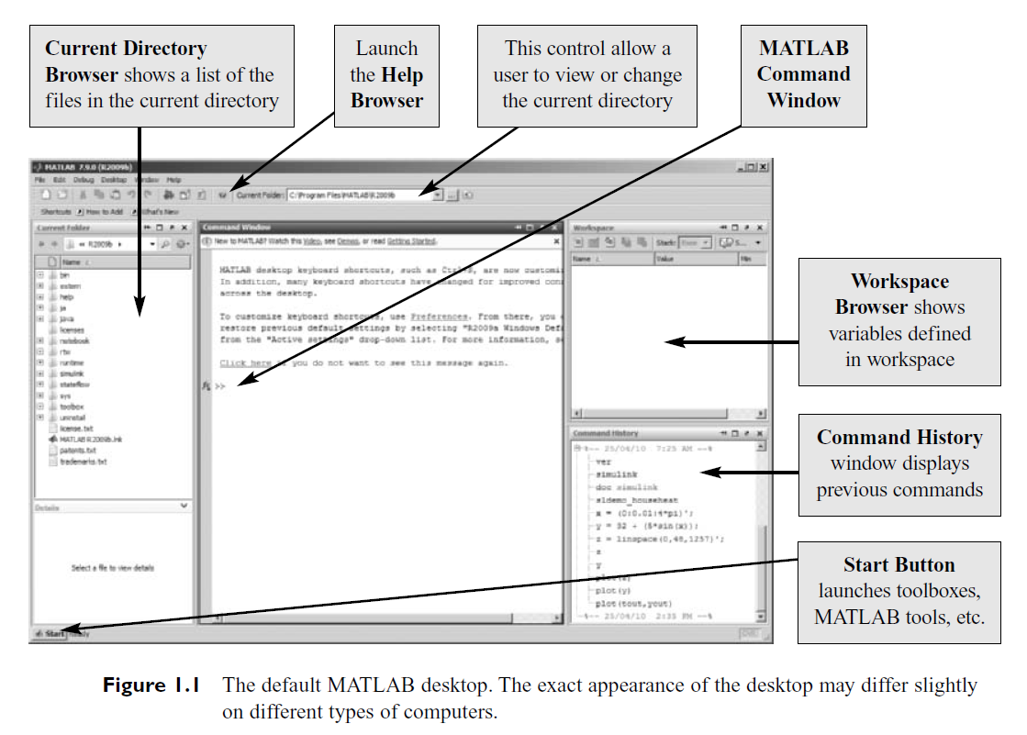
The Matlab Environment

Slide 5
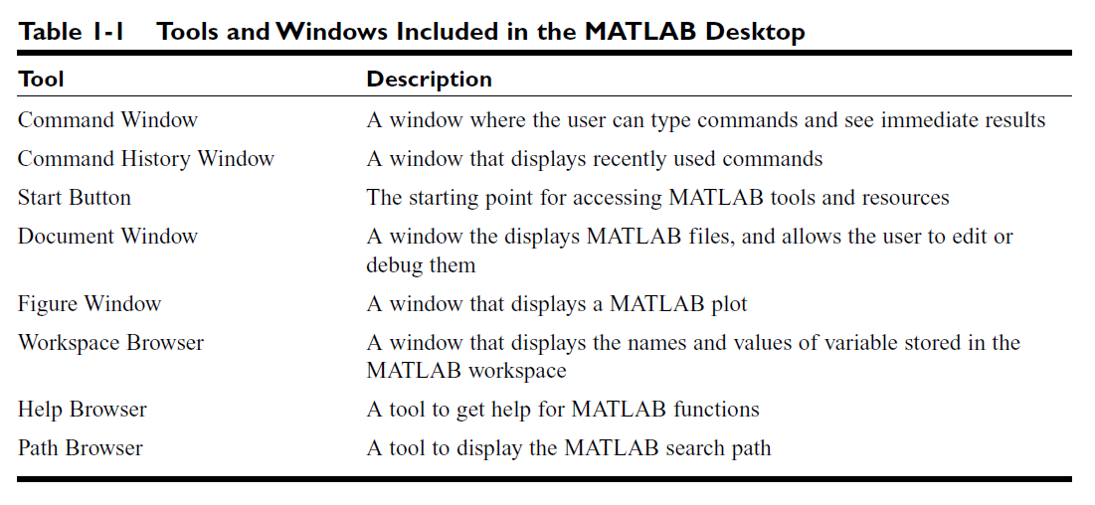
The Matlab Environment

Slide 6
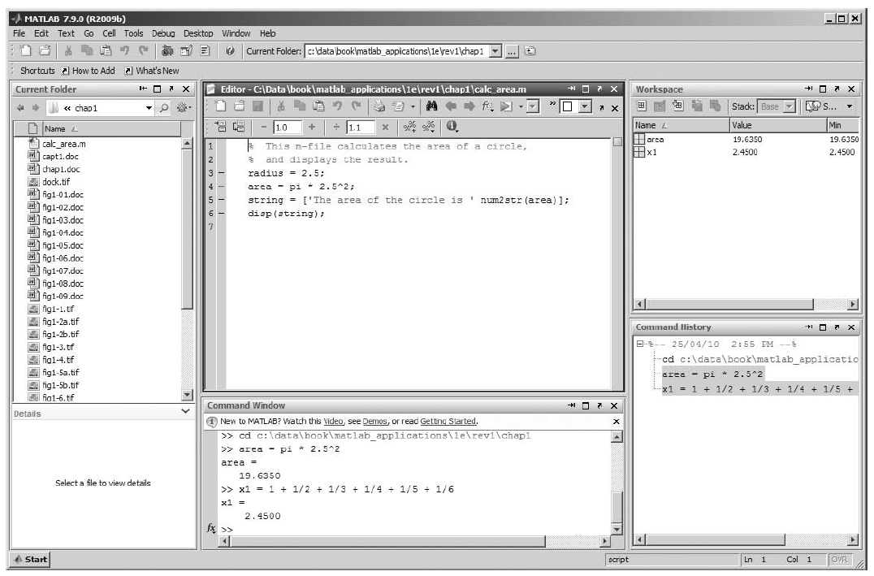
The Matlab Editor (docked to Matlab Desktop)

Slide 7
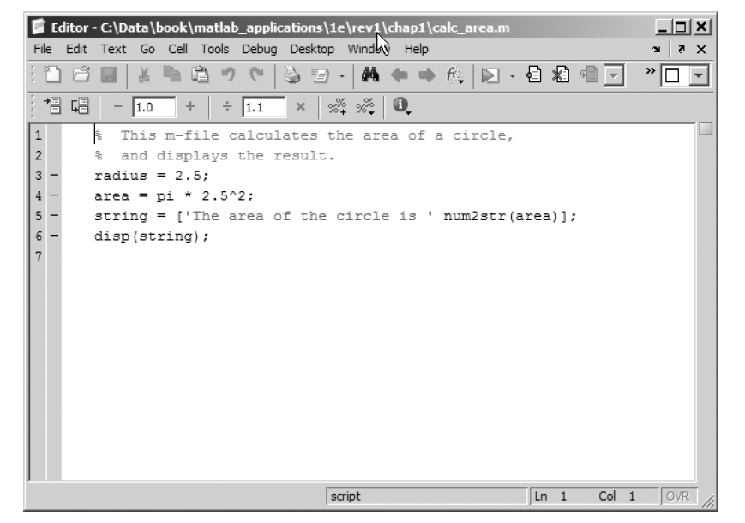
The Matlab Editor (undocked)
We will use Notepad++ instead

Slide 8
Matlab Script File (.m file)
For long programs, use script file instead of typing directly in the command window
  This is your Matlab code (.m files)
  In Fortran, your code is in .f files
You can correct your code easily in an editor and rerun
Also serves as a record of your command history

Slide 9
Navigation, File commands
DOS/Unix conventions for directory navigation
Tab completion to speed up keystrokes
Command history via Up/Down Arrow keys to speed up keystrokes
Learn and continually use it to make it second nature

