Slide 1
SCSJ 2733
Matlab - Basics
Mohsin Mohd Sies
School of Chemical and Energy Engineering
Major credits to
Professor Sophocles Orfanidis
Rutgers University

Slide 2
6. Arrays and Matrices
arrays and matrices are the most important data objects in MATLAB
Last week we discussed one-dimensional arrays,
i.e., column or row vectors.
Next, we discuss matrices, which are two-dimensional
arrays. We will explore them further in Chapters 4 & 10.

Slide 3
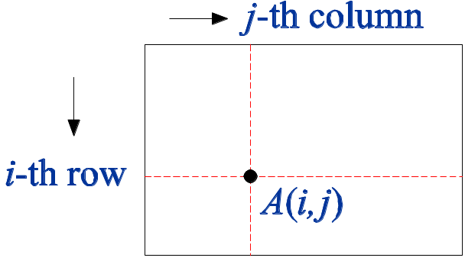
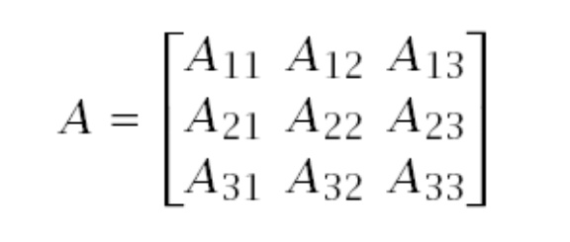
matrix indexing
convention
>> A = [1 2 3; 2 0 4; 0 8 5]
A =
1 2 3
2 0 4
0 8 5
>> size(A) % [N,M] = size(A), NxM matrix
ans =
3 3

Slide 4
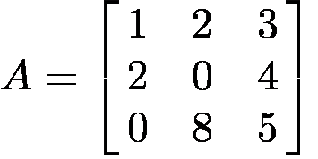
accessing matrix elements:
>> A(1,1) % 11 matrix element
ans =
1
>> A(2,3) % 23 matrix element
ans =
4
>> A(:,2) % second column
ans =
2
0
8
>> A(3,:) % third row
ans =
0 8 5

Slide 5
transposing a matrix:
rows become columns and vice versa
>> A = [1 2 3 4; 2 0 5 6; 0 8 7 9] % size 3x4
A =
1 2 3 4
2 0 5 6
0 8 7 9
>> A' % size 4x3
ans =
1 2 0
2 0 8
3 5 7
4 6 9
=>
transposition operation

Slide 6
For more information on elementary matrices see:
>> help elmat
Elementary matrices and matrix manipulation.
Elementary matrices:
zeros - matrix of zeros
ones - matrix of ones
eye - identity matrix
repmat - replicate and tile an array
linspace - linearly spaced vector
logspace - logarithmically spaced vector
etc.

Slide 7
7. Operators and Expressions
operation element-wise matrix-wise
addition + +
subtraction - -
multiplication .* *
division ./ /
left division .\ \
exponentiation .^ ^
transpose w/o complex conjugation .'
transpose with complex conjugation '
these must follow the rules of linear algebra
>> help /
>> help precedence

Slide 8
>> a = [1 2 5];
>> b = [4 -5 1];
>> a+b
ans =
5 -3 6
>> a.*b
ans =
4 -10 5
>> a./b
ans =
0.2500 -0.4000 5.0000
>> a.\b
ans =
4.0000 -2.5000 0.2000
% note: (a./b).*(a.\b) = [1,1,1]

Slide 9
>> a = [2 3 4 5];
>> a.^2 % [2^2, 3^2, 4^2, 5^2]
ans =
4 9 16 25
>> 2.^a % [2^2, 2^3, 2^4, 2^5]
ans =
4 8 16 32
>> a+10
ans =
12 13 14 15

Slide 10
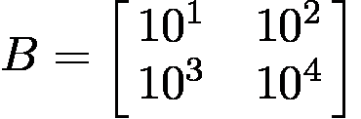
>> A = [1 2; 3 4]
A =
1 2
3 4
>> [A, A.^2; A^2, A*A] % form sub-blocks
ans =
1 2 1 4
3 4 9 16
7 10 7 10 % note A^2 = A*A
15 22 15 22
>> B = 10.^A;
>> [B, log10(B)]
ans =
10 100 1 2
1000 10000 3 4

Slide 11
8. Functions
>> help elfun % elementary functions list
Some typical built-in elementary functions are:
sin(x), cos(x), tan(x), cot(x)
asin(x), acos(x), atan(x), acot(x)
sinh(x), cosh(x), tanh(x), coth(x)
asinh(x), acosh(x), atanh(x), acoth(x)
exp(x), log(x), log10(x), log2(x)
fix(x), floor(x), ceil(x), round(x)
sqrt(x), sign(x), abs(x)
sum(x), prod(x), cumsum(x), cumprod(x)

Slide 12
Some more functions:
size(x), length(x), class(x)
sinc(x) % sin(pi*x)/(pi*x)
max(x), min(x), sort(x)
mean(x), std(x), % statistics
median(x), mode(x)
rand, randn, % random number generators
randi, rng % initialize with rng
filter, conv, fft % DSP functions
clock, date
factorial(n), nchoose(n,k) % discrete math
for a complete list, see Appendix A of your text

Slide 13
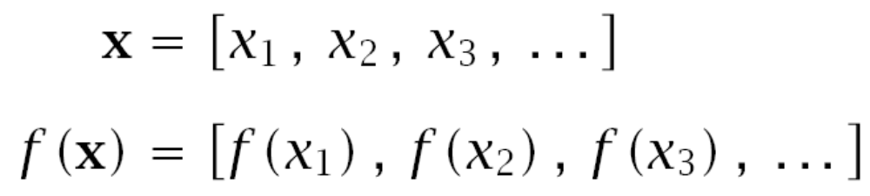
Most functions admit scalar or array and matrix input
arguments and operate on each element of the array
>> x = [0, pi/4, pi/3, pi/2, pi];
>> sin(x)
ans =
0 0.7071 0.8660 1.0000 0.0000
>> sin(sym(x)) % use symbolic toolbox
% to see exact expressions
ans =
[ 0, 2^(1/2)/2, 3^(1/2)/2, 1, 0]

Slide 14
>> x = [2.1, 2.8, -3.1, -3.5, 4.5];
>> y = exp(x)
y =
8.1662 16.4446 0.0450 0.0302 90.0171
>> z = log(y) % note log(exp(x)) = x
z =
2.1000 2.8000 -3.1000 -3.5000 4.5000
>> [fix(x); floor(x); ceil(x); round(x)]
ans =
2 2 -3 -3 4
2 2 -4 -4 4
3 3 -3 -3 5
2 3 -3 -4 5

Slide 15
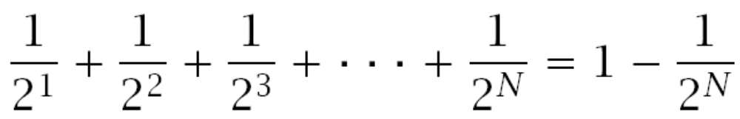
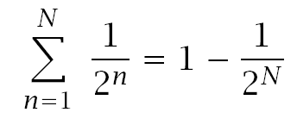
Example: verify the following geometric-series identity
using the function sum(x),
summation
notation
>> format long;
>> N = 8; n = 1:N; % n = [1, 2, ..., 8 ]
% [1/2^1, 1/2^2, ..., 1/2^8]
>> sum(1./2.^n) % note the operations ./ and .^
>> 1 - 2^(-N)
ans =
0.996093750000000
ans =
0.996093750000000

Slide 16
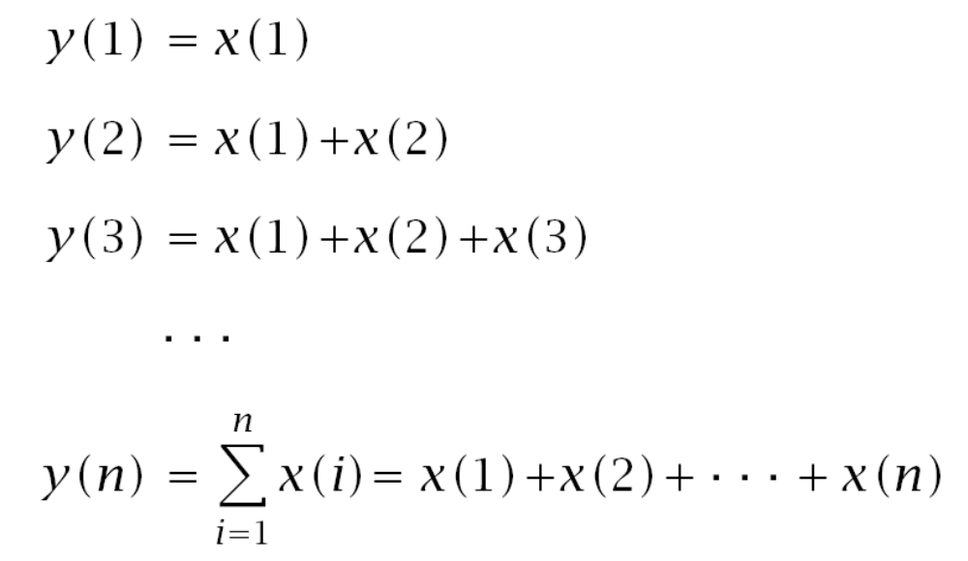
y = cumsum(x) – cumulative sum of the elements of x
x = [y(1), diff(y)] % inverse operation

Slide 17
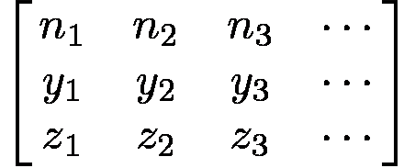
cumsum - Example 1
>> N = 8; n = 1:N; % n is a row vector
>> y = cumsum(1./2.^n); % y,z should be equal
>> z = 1 - 1./2.^n;
>> fprintf('%d %10.8f %10.8f\n',[n; y; z]);
1 0.50000000 0.50000000
2 0.75000000 0.75000000
3 0.87500000 0.87500000
4 0.93750000 0.93750000
5 0.96875000 0.96875000
6 0.98437500 0.98437500
7 0.99218750 0.99218750
8 0.99609375 0.99609375
fprintf operates
column-wise on the 3x8
matrix [n; y; z], i.e.,

Slide 18
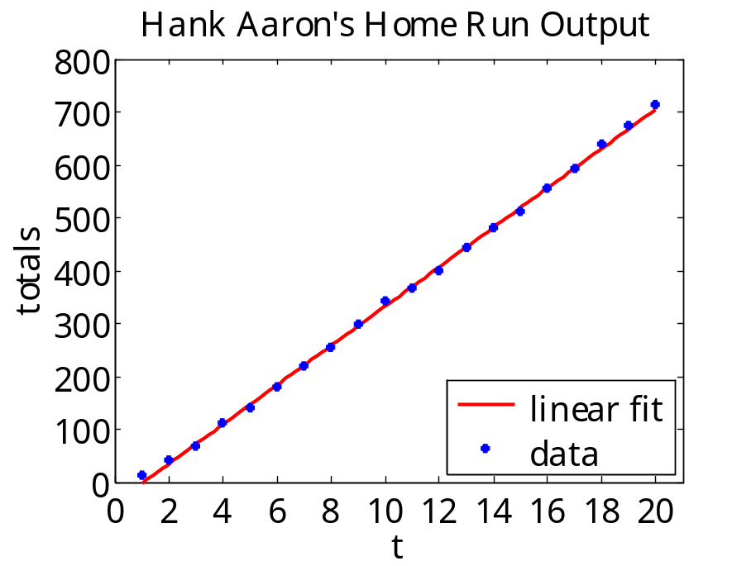
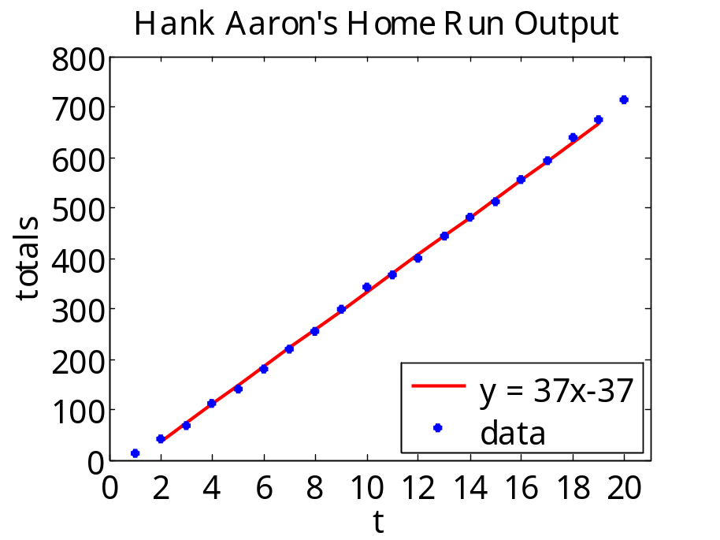
cumsum
Example 2
% aaron.dat
% year ti H
% ---------------
1954 1 13
1955 2 27
1956 3 26
1957 4 44
1958 5 30
1959 6 39
1960 7 40
1961 8 34
1962 9 45
1963 10 44
1964 11 24
1965 12 32
1966 13 44
1967 14 39
1968 15 29
1969 16 44
1970 17 38
1971 18 47
1972 19 34
1973 20 40

Slide 19
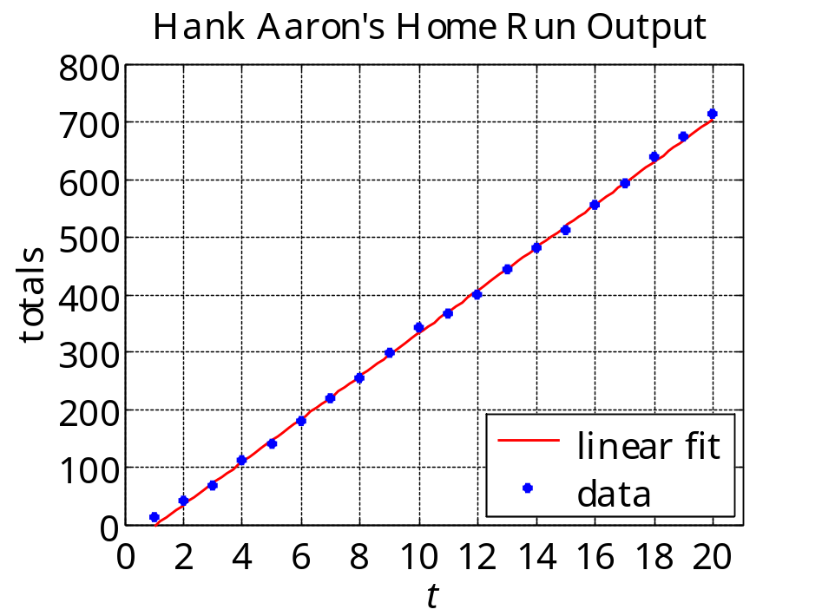
A = load('aaron.dat');
ti = A(:,2); % column 2
H = A(:,3); % column 3
yi = cumsum(H);
p = polyfit(ti,yi,1)
% p = 37.2617 -39.8474
% y = p(1)*t + p(2);
t = linspace(1,20, 101);
y = polyval(p,t);
plot(t,y,'r-', ti,yi,'b.', 'markersize', 18);
xlabel('\itt'); ylabel('totals');
xaxis(0,21,0:2:20); yaxis(0,800,0:100:800); grid on;
title('Hank Aaron''s Home Run Output');
legend(' linear fit', ' data', 'location', 'se');
print -dmeta aaron.wmf

Slide 20
Random numbers, min, max, mean, std, sort
>> seed = 127; rng(seed);
>> x = randn(5,3)
x =
0.0294 -1.0928 1.6686
-1.5732 -0.1697 -0.4750
-1.1899 0.5751 -0.7604
1.8115 0.6548 -1.1189
0.0426 -0.0969 0.1698
>> min(x), max(x), mean(x), std(x)
ans =
-1.5732 -1.0928 -1.1189
ans =
1.8115 0.6548 1.6686
ans =
-0.1759 -0.0259 -0.1032
ans =
1.3248 0.7051 1.0972
initialize generator,
5x3 matrix of zero-mean,
unit-variance, gaussian,
random numbers
>> help rng
>> help rand
>> help randn
>> help randi
computed column-wise
MATLAB is
column-dominant

Slide 21
x =
0.0294 -1.0928 1.6686
-1.5732 -0.1697 -0.4750
-1.1899 0.5751 -0.7604
1.8115 0.6548 -1.1189
0.0426 -0.0969 0.1698
>> [m,i] = min(x), min(min(x))
m =
-1.5732 -1.0928 -1.1189
i =
2 1 4
ans =
-1.5732
>> sort(x)
ans =
-1.5732 -1.0928 -1.1189
-1.1899 -0.1697 -0.7604
0.0294 -0.0969 -0.4750
0.0426 0.5751 0.1698
1.8115 0.6548 1.6686
min,max,sort
act column-wise
on matrix inputs
i=2
minimum of each column,
index within each column,
overall minimum
sort each column in
ascending order
sort(x,'ascend')
sort(x,'descend')

Slide 22
x =
0.0294 -1.0928 1.6686
-1.5732 -0.1697 -0.4750
-1.1899 0.5751 -0.7604
1.8115 0.6548 -1.1189
0.0426 -0.0969 0.1698
>> [x2,i2] = sort(x(:,2),'descend');
>> [x2,i2]
0.6548 4
0.5751 3
-0.0969 5
-0.1697 2
-1.0928 1
>> x_sort = x(i2,:) % sort x relative to column 2
1.8115 0.6548 -1.1189
-1.1899 0.5751 -0.7604
0.0426 -0.0969 0.1698
-1.5732 -0.1697 -0.4750
0.0294 -1.0928 1.6686
sort column 2 only in descending order
x2 = sorted column, i2 = sorting index
% using sortrows:
sortrows(x,-2)

Slide 23
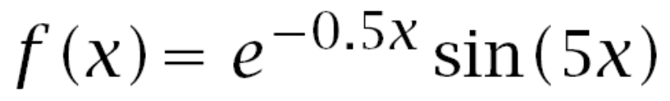
Make up your own functions using three methods:
1. function-handle, @(x)
2. inline
3. M-file
example:
>> f = @(x) exp(-0.5*x).*sin(5*x);
>> g = inline('exp(-0.5*x).*sin(5*x)');
% edit & save file h.m containing the lines:
function y = h(x)
y = exp(-0.5*x).*sin(5*x);
.* allows vector or matrix inputs x

Slide 24

How to include parameters in functions
example:
% method 1: define a,b first, then define f
a = 0.5; b = 5;
f = @(x) exp(-a*x).*sin(b*x);
% method 2: pass parameters as arguments to f
f = @(x,a,b) exp(-a*x).*sin(b*x);
% this defines the function f(x,a,b)
% so that f(x, 0.5, 5) would be equivalent to
% the f(x) defined in method 1.

Slide 25
9. Basic Plotting
MATLAB has extensive facilities for the plotting of curves and surfaces, and visualization. We will be discussing these in detail later on.
Basic 2D plots of functions and (x,y) pairs can be done with the functions:
plot, fplot, ezplot
>> help plot % 2-D plotting
>> help fplot % function plotting
>> help ezplot % easy function plotting

Slide 26
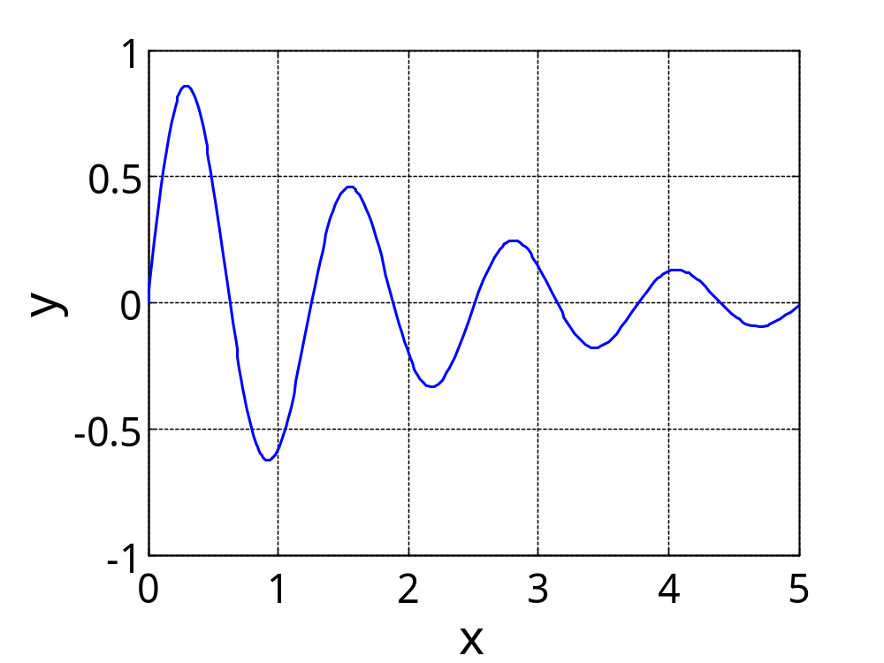
If a function f(x) has already been defined by a function-handle or inline, it can be plotted quickly with fplot, ezplot, which are very similar. One only needs to specify the plot range. For example:
>> f = @(x) exp(-0.5*x).*sin(5*x);
>> fplot(f,[0,5]); % plot over interval [0,5]
A figure window opens up, allowing further editing of the graph, e.g., adding x,y axis labels, titles, grid, changing colors, and saving the graph is some format, such as WMF, PNG, or EPS.

Slide 27
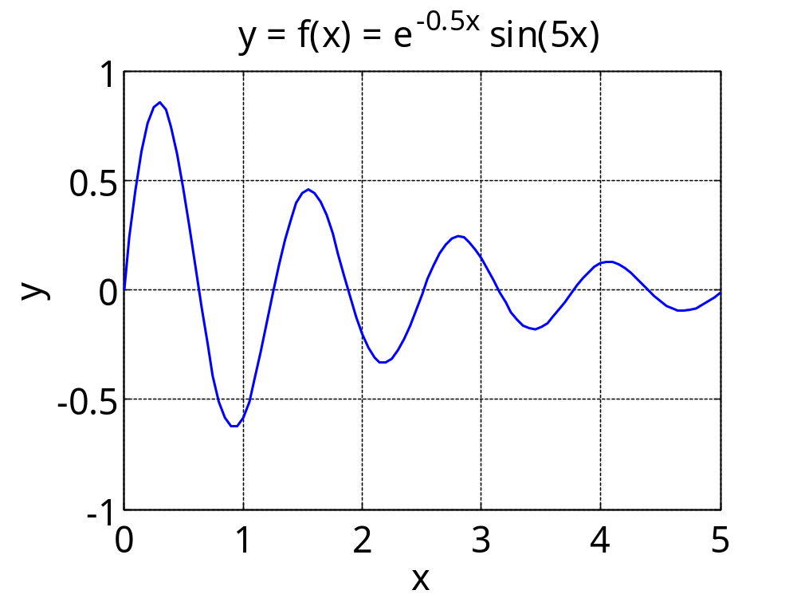
using the plot function
>> x = linspace(0,5,101);
>> y = f(x);
>> plot(x,y,'b-'); % blue-solid line
>> xlabel('x'); ylabel('y'); grid;
>> title('f(x) = e^{-0.5x} sin(5x)');
plot annotation can be done
by separate commands, as
shown above, or from the plot
editor in the figure window.

Slide 28
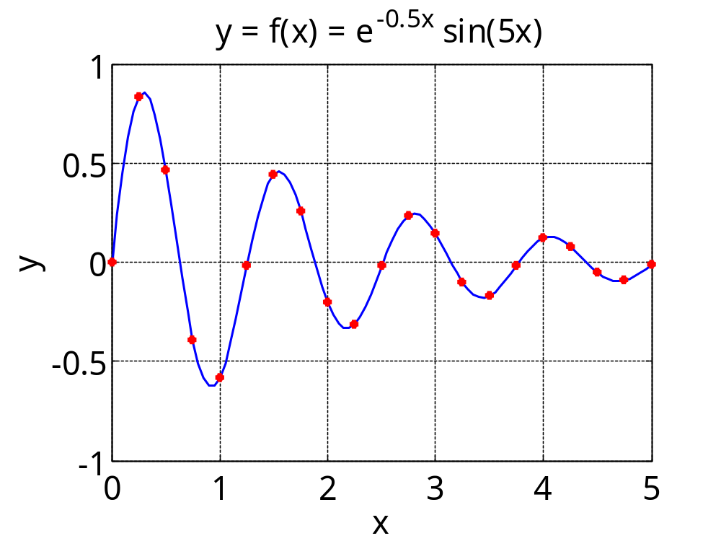
multiple graphs on same plot
>> x5 = x(1:5:end); % plot every 5th data point
>> y5 = y(1:5:end);
>> plot(x,y,'b-', x5,y5, 'r.'); % blue-line, red dots
>> xlabel('x'); ylabel('y'); grid;
>> title('f(x) = e^{-0.5x} sin(5x)');
(x,y) plotted as blue-solid line
(x5,y5) pairs plotted as red dots
multiple (x,y) pairs---not
necessarily of the same
size---can be plotted with
different line styles.

Slide 29
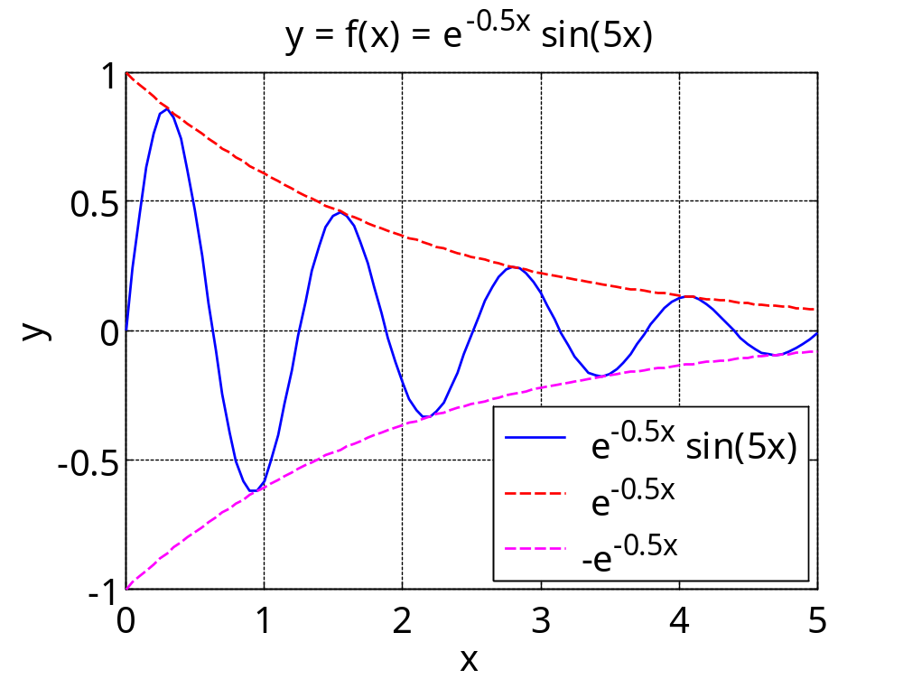
>> e = exp(-0.5*x); % envelope of f(x)
>> plot(x,y,'b-', x,e,'r--', x,-e,'m--' );
>> xlabel('x'); ylabel('y'); grid;
>> title('f(x) = e^{-0.5x} sin(5x)');
>> legend('e^{-0.5x} sin(5x)', 'e^{-0.5x}', ...
'-e^{-0.5x}', 'location','SE');
ellipsis
continues to
next line
south-east
plotting multiple curves
and adding legends
legends can also be
inserted with plot editor

Slide 30
10. Function Maxima and Minima
Engineers always like to optimize their designs by finding
the best possible solutions. This usually amounts to
minimizing or maximizing some function of the design
parameters.
Suppose a function f(x) has a minimum (or maximum) within an
interval [a,b], or, a ≤ x ≤ b. The following three methods can
be used to find it:
1. Graphical method using the function min (or max)
2. Using the built-in function fminbnd
3. Using the function fzero, (requires the derivative of f(x) )
(use fminsearch for multivariable functions)

Slide 31
MATLAB implementation of the three methods
f = @(x) ... % define your function here
% f(x) must admit vector inputs
% and return vector outputs
x = linspace(a,b,N); % larger N works better
[fmin,imin] = min(f(x)); % fmin = minimum value
xmin = x(imin); % x-location of minimum
plot(x,f(x), xmin,fmin,'o'); % display it
[xmin,fmin] = fminbnd(f,a,b); % search in [a,b]
F = @(x) ... % define derivative of f(x)
% or use symbolic toolbox
xmin = fzero(F,x0); % search near x0
fmin = f(xmin); % minimum value of f(x)
1.
2.
3.

Slide 32
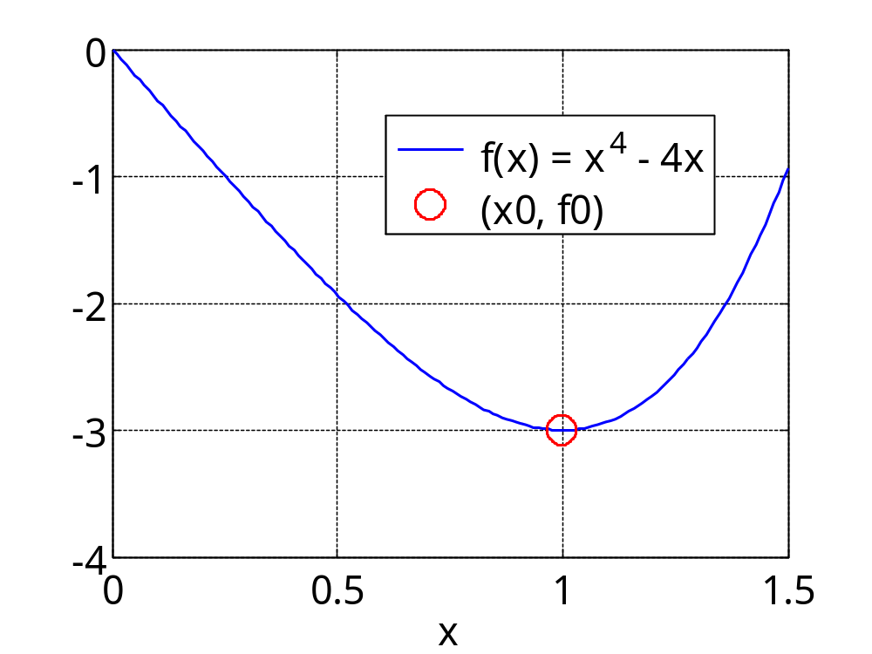
f = @(x) x.^4 - 4*x;
x = linspace(0, 1.5, 151);
[f0,i0] = min(f(x)); x0 = x(i0);
plot(x,f(x),'b-', x0,f0,'ro');
xlabel('x'); grid;
legend('f(x)=x^4-4x', '(x0,f0)');
Example: finding
the minimum of a
curve using the
function min
f0 is minimum of
the array y=f(x)
i0 is the index of
array at its min,
i.e., f0=y(i0)
x0 is value of x at
the minimum of y
exact values are:
x0 = 1
f0 = -3

Slide 33
both fminbnd and
fzero admit function
handles as inputs
finding the minimum of f(x) using
the function fminbnd
f = @(x) x.^4 – 4*x; % find minimum of f(x)
[x1,f1] = fminbnd(f,0,1.5); % in the interval[0,1.5]
finding the minimum of f(x) using the function
fzero, requires derivative F(x) = df(x)/dx
F = @(x) 4*x.^3 - 4; % derivative of f(x)
x2 = fzero(F, 0.5); f2 = f(x2);
[x0,x1,x2; f0,f1,f2] % compare the three methods
ans =
0.9966 1.0000 1.0000
-2.9999 -3.0000 -3.0000

Slide 34
How to find the maximum of a function f(x) using fminbnd
f = @(x) ... % define your function here
% f(x) must admit vector inputs
% and return vector outputs
[xmax,fmin] = fminbnd(@(x) –f(x), a,b);
fmax = -fmin;
% fminbnd(-f,a,b) is not allowed
% alternatively, first define negative of f(x)
g = @(x) –f(x); % i.e., g(x) = -f(x)
[xmax,fmin] = fminbnd(g,a,b);
fmax = -fmin;
function handle

Slide 35
11. Strings, fprintf
characters and strings
concatenating strings
using num2str
comparing strings with strcmp
fprintf – summary & examples

Slide 36
MATLAB Data Classes
Character
Logical
Numeric
Symbolic
Cell
Structure
Integer
Floating Point
signed
unsigned
single precision
double precision
More Classes
Cell and Structure arrays can store different types of data in the same array
Java
classes
user-defined
classes
function
handles

Slide 37
Characters and Strings
Strings are arrays of characters.
Characters are represented internally
by standardized numbers, referred to as ASCII (American Standard Code for Information Interchange) codes.
see Wikipedia link: ASCII table
>> c = 'A'
c =
A
>> x = double(c)
x =
65 % ASCII code for 'A'
>> char(x)
ans =
A
>> class(c)
ans =
char
char() creates a character string
>> doc char
>> doc class

Slide 38
>> s = 'ABC DEFG'
s =
ABC DEFG
>> x = double(s)
x =
65 66 67 32 68 69 70 71
>> char(x)
ans =
ABC DEFG
>> size(s)
ans =
1 8
>> class(s)
ans =
char
ASCII codes
convert ASCII codes to characters
s is a row vector of 8 characters
>> s(2), s(3:5)
ans =
B
ans =
C D

Slide 39
Concatenating Strings
s = ['Albert', 'Einstein']
s =
AlbertEinstein
>> s = ['Albert', ' Einstein']
s =
Albert Einstein
>> s = ['Albert ', 'Einstein']
s =
Albert Einstein
>> size(s)
ans =
1 15
preserve leading and trailing spaces
>> doc strcat
>> doc strvcat
>> doc num2str
>> doc strcmp
>> doc findstr

Slide 40
Concatenating Vertically
s = ['Apple'; 'IBM'; 'Microsoft'];
??? Error using ==> vertcat
CAT arguments dimensions are not consistent.
s = ['Apple '; 'IBM '; 'Microsoft']
s =
Apple
IBM
Microsoft
>> size(s)
ans =
3 9
padded with spaces to the
length of the longest string

Slide 41
Concatenating Vertically
s = strvcat('Apple', 'IBM', 'Microsoft');
s = char('Apple', 'IBM', 'Microsoft');
s =
Apple
IBM
Microsoft
>> size(s)
ans =
3 9
strvcat,char
both pad spaces as necessary
Recommendation:
use char to concatenate vertically, and [] to concatenate horizontally

Slide 42
num2str
a = [143.87, -0.0000325, -7545]';
>> s = num2str(a)
s =
143.87
-3.25e-005
-7545
>> s = num2str(a,4)
s =
143.9
-3.25e-005
-7545
>> s = num2str(a, '%12.6f')
s =
143.870000
-0.000032
-7545.000000
s = num2str(A)
s = num2str(A, precision)
s = num2str(A, format)
max number of digits
format spec

Slide 43
Comparing Strings
Strings are arrays of characters, so the condition s1==s2 requires both s1 and s2 to have the same length
>> s1 = 'short'; s2 = 'shore';
>> s1==s1
ans =
1 1 1 1 1
>> s1==s2
ans =
1 1 1 1 0
>> s1 = 'short'; s2 = 'long';
>> s1==s2
??? Error using ==> eq
Matrix dimensions must agree.

Slide 44
Comparing Strings
Use strcmp to compare
strings of unequal length,
and get a binary decision
>> s1 = 'short'; s2 = 'shore';
>> strcmp(s1,s1)
ans =
1
>> strcmp(s1,s2)
ans =
0
>> s1 = 'short'; s2 = 'long';
>> strcmp(s1,s2)
ans =
0
>> doc strcmp
>> doc strcmpi
case-insensitive

Slide 45
Useful String Functions
sprintf - write formatted string
sscanf - read formatted string
deblank - remove trailing blanks
strcmp - compare strings
strcmpi - compare strings
strmatch - find possible matches
upper - convert to upper case
lower - convert to lower case
blanks - string of blanks
strjust - left/right/center justify string
strtrim - remove leading/trailing spaces
strrep - replace strings
findstr - find one string within another

Slide 46
fprintf – summary & examples
fprintf('format_specs', variables);
print format
specifications
list of variables,
arrays, or matrices
to be printed
>> doc fprintf
>> doc sprintf
see Sect.7.2 of text

Slide 47
>> fprintf('%10.6f\n', 100*pi)
>> fprintf('% 10.6f\n', 100*pi)
>> fprintf('%-10.6f\n', 100*pi)
>> fprintf('%+10.6f\n', 100*pi)
>> fprintf('%10.0f\n', 100*pi)
>> fprintf('%#10.0f\n', 100*pi)
>> fprintf('%010.0f\n', 100*pi)
314.159265
314.159265
314.159265
+314.159265
314
314.
0000000314
Example 1
different ways of printing 100*pi
10 spaces

Slide 48
%10.6f % width 10, 6 decimal places
% 10.6f % leave space before field
%-10.6f % left-justify field
%+10.6f % print + or – signs
%10.0f % no decimals
%#10.0f % print decimal point
%010.0f % pad with zeros
flag
conversion character:
d, i integer format
f fixed-point format
e, E, g exponential format
c, s character or string
x hexadecimal format
field width & precision

Slide 49
Example 2
a = [1; -2; 3; 4;];
b = [10; 20; -30; 40];
c = [100; 200; 300; -400];
fprintf('%9.3f %9.3f %9.3f\n', [a, b, c]');
1.000 10.000 100.000
-2.000 20.000 200.000
3.000 -30.000 300.000
4.000 40.000 -400.000
for i=1:4,
fprintf('%9.3f %9.3f %9.3f\n', a(i),b(i),c(i));
end
>> [a, b, c]
ans =
1 10 100
-2 20 200
3 -30 300
4 40 -400
need at least %6.3f
to align first column
vectorized version
loop version

Slide 50
Example 3 - text & numbers
a = [1; -2; 3; 4;];
b = [10; 20; -30; 40];
s = {'a', 'bb', 'ccc', 'dddd'};
for i=1:4,
fprintf('%9.3f %9.3f %4s\n', a(i),b(i),s{i});
end
1.000 10.000 a
-2.000 20.000 bb
3.000 -30.000 ccc
4.000 40.000 dddd
N = [num2cell([a';b']); s];
fprintf('%9.3f %9.3f %-4s\n', N{:});
1.000 10.000 a
-2.000 20.000 bb
3.000 -30.000 ccc
4.000 40.000 dddd
cell array of strings
note curly brackets
max 4 characters
using
a single
fprintf
command
left-justified

Slide 51
>> N{:} % fprintf('%9.3f %9.3f %-4s\n', N{:});
ans =
1
10
a
-2
20
bb
3
-30
ccc
4
40
dddd
use the three format specs to print
each group of three entries in new row
1.000 10.000 a
-2.000 20.000 bb
3.000 -30.000 ccc
4.000 40.000 dddd
>> N
N =
[ 1] [-2] [ 3] [ 4]
[10] [20] [-30] [ 40]
'a' 'bb' 'ccc' 'dddd'

