Slide 1
SCSJ 2733
Matlab – Basic Applications
Linear Algebra, Polynomials
Mohsin Mohd Sies
School of Chemical and Energy Engineering
Major credits to
Professor Sophocles Orfanidis
Rutgers University

Slide 2
Linear Algebraic Equations

Slide 3
Solution of Linear Algebraic Equations
6x + 12y + 4z = 70
7x – 2y + 3z = 5
2x + 8y – 9z = 64
>>A = [6,12,4;7,-2,3;2,8,-9];
>>B = [70;5;64];
>>Solution = A\B
Solution =
3
5
-2
The solution is x = 3, y = 5, and z = –2.
Left division
(uses Gaussian Elimination)

Slide 4
Solution of Linear Algebraic Equations
(Alternatively)
6x + 12y + 4z = 70
7x – 2y + 3z = 5
2x + 8y – 9z = 64
>>A = [6,12,4;7,-2,3;2,8,-9];
>>B = [70;5;64];
>>Solution = inv(A)*B
Solution =
3
5
-2
The solution is x = 3, y = 5, and z = –2.

Slide 5
Working with Polynomials

Slide 6
Polynomial Roots
To find the roots of x³ – 7x² + 40x – 34 = 0, the session is
>>a = [1,-7,40,-34];
>>roots(a)
ans =
3.0000 + 5.000i
3.0000 - 5.000i
1.0000
The roots are x = 1 and x = 3 ± 5i.
How to express polynomials
in Matlab

Slide 7
Polynomial Roots
The function roots(a)computes the roots of a polynomial specified by the coefficient array a. The result is a column vector that contains the polynomial’s roots.
For example,
>>r = roots([2, 14, 20])
r =
-2
-7

Slide 8
Polynomial Coefficients
The function poly(r)computes the coefficients of the polynomial whose roots are specified by the vector r. The result is a row vector that contains the polynomial’s coefficients arranged in descending order of power.
For example,
>>c = poly([-2, -7])
c =
1 7 10

Slide 9
Plotting Polynomials
The function polyval(a,x)evaluates a polynomial at specified values of its independent variable x, which can be a matrix or a vector. The polynomial’s coefficients of descending powers are stored in the array a. The result is the same size as x.

Slide 10
Example of Plotting a Polynomial
To plot the polynomial f (x) = 9x³ – 5x² + 3x + 7 for –2 ≤ x ≤ 5, you type
>>a = [9,-5,3,7];
>>x = [-2:0.01:5];
>>f = polyval(a,x);
>>plot(x,f),xlabel(’x’),ylabel(’f(x)’)

Slide 11
Plotting Polynomials with the polyval Function.
To plot the polynomial 3x⁵ + 2x⁴ – 100x³ + 2x² – 7x + 90 over the range –6 ≤ x ≤ 6 with a spacing of 0.01, you type
>>x = [-6:0.01:6];
>>p = [3,2,-100,2,-7,90];
>>plot(x,polyval(p,x)),xlabel(’x’), ...
ylabel(’p’)

Slide 12
The polyfit function.
Command
p = polyfit(x,y,n)
Description
Fits a polynomial of degree n to data described by the vectors x and y, where x is the independent variable. Returns a row vector p of length n + 1 that contains the polynomial coefficients in order of descending powers.

Slide 13
Using the polyfit Function to Fit Equations to Data.
Syntax: p = polyfit(x,y,n)
where x and y contain the data, n is the order of the polynomial to be fitted, and p is the vector of polynomial coefficients.
The linear function: y = mx + b. In this case the variables w and z in the polynomial w = p₁z+ p₂ are the original data variables x and y, and we can find the linear function that fits the data by typing p = polyfit(x,y,1). The first element p₁ of the vector p will be m, and the second element p₂ will be b.

Slide 14
The polyfit function is based on the least-squares method. Its syntax is
p = polyfit(x,y,n)
Fits a polynomial of degree n to data described by the vectors x and y, where x is the independent
variable. Returns a row vector p of length n+1 that contains the polynomial coefficients in order of descending powers.

Slide 15
Example - Fitting an exponential function. Temperature of a cooling cup of coffee, plotted on various coordinates
The temperature of coffee cooling in a porcelain mug at room temperature (68F) was measured at various times. The data follow.
EXAMPLE 6.1–1
Time t (sec) Temperature T (F)
0 145
620 130
2266 103
3482 90
Develop a model of the coffee’s temperature as a function of time, and use the model to estimate how long it took the temperature to reach 120F.

Slide 16
■ Solution
Because T(0) is finite but nonzero, the power function cannot describe these data, so we do not bother to plot the data on log-log axes. Common sense tells us that the coffee will cool
and its temperature will eventually equal the room temperature. So we subtract the room temperature from the data and plot the relative temperature, T - 68, versus time. If the relative temperature is a linear function of time, the model is T – 68 = mt + b. If the relative temperature is an exponential function of time, the model is T - 68 = b(10)^{mt} . Figure 6.1.3 shows the plots used to solve the problem. The following MATLAB script le generates the top two plots. The time data are entered in the array time, and the temperature data are entered in temp.

Slide 17
% Enter the data.
time = [0,620,2266,3482];
temp = [145,130,103,90];
% Subtract the room temperature.
temp = temp - 68;
% Plot the data on rectilinear scales.
subplot(2,2,1)
plot(time,temp,time,temp,’o’), ...
xlabel(‘Time (sec)’), ...
ylabel(‘Relative Temperature (deg F)’)
%
% Plot the data on semilog scales.
subplot(2,2,2)
semilogy(time,temp,time,temp,’o’), ...
xlabel(‘Time (sec)’),...
ylabel(‘Relative Temperature (deg F)’

Slide 18
% Fit a straight line to the transformed data.
p = poly t(time,log10(temp),1);
m = p(1)
b = 10^p(2)
% Compute the time to reach 120 degrees.
t_120 = (log10(120-68)-log10(b))/m

Slide 19
% Show the derived curve and estimated point on semilog scales.
t = 0:10:4000;
T = 68+b*10.^(m*t);
subplot(2,2,3)
semilogy(t,T-68,time,temp,’o’,t_120,120-68,’+’),
xlabel(‘Time (sec)’),...
ylabel(‘Relative Temperature (deg F)’)
%
% Show the derived curve and estimated point on rectilinear
% scales.
subplot(2,2,4)
plot(t,T,time,temp+68,’o’,t_120,120,’+’), ...
xlabel(‘Time (sec)’), ylabel(‘Temperature (deg F)’)

Slide 20
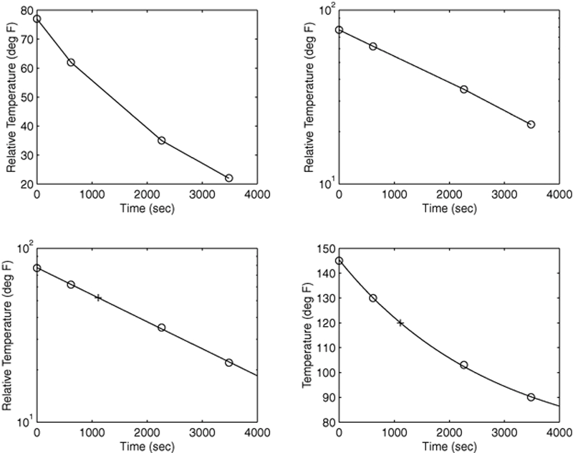
Fitting an exponential function. Temperature of a cooling cup of coffee, plotted on various coordinates.

Slide 21
Example of a Script File
Problem:
The speed v of a falling object dropped with no initial velocity is given as a function of time t by v = gt.
Plot v as a function of t for 0 ≤ t ≤ t_{f}, where t_{f} is the final time entered by the user.

Slide 22
Script file name is falling_speed.m
Example of a Script File (continued)
% Program falling_speed.m:
% Plots speed of a falling object.
% Created on March 1, 2004 by W. Palm
%
% Input Variable:
% tf = final time (in seconds)
%
% Output Variables:
% t = array of times at which speed is % computed (in seconds)
% v = array of speeds (meters/second)

Slide 23
Example of a Script File (continued)
% Parameter Value:
g = 9.81; % Acceleration in SI units
%
% Input section:
tf = input(’Enter final time in seconds:’);
%

Slide 24
Example of a Script File (continued)
% Calculation section:
dt = tf/500;
% Create an array of 501 time values.
t = [0:dt:tf];
% Compute speed values.
v = g*t;
%
% Output section:
Plot(t,v),xlabel(’t (s)’),ylabel(’v m/s)’)

