Slide 1
SCSJ 2733
Matlab
Mohsin Mohd Sies
School of Chemical and Energy Engineering
Major credits to
Professor Sophocles Orfanidis
Rutgers University

Slide 2
Topics
Relational and logical operators
Precedence rules
Logical indexing
find function
Program flow control
if – statements
switch – statements
Examples:
piece-wise functions, unit-step function, indicator
functions, sinc function, echoes

Slide 3
Relational and Logical Operators
Relational and logical functions
find, logical, true, false, any, all
ischar, isequal, isfinite, isinf, isinteger
islogical, isnan, isreal
>> doc is* % list of all 'is' functions
>> help logical % convert to logical
>> help true % logical 1
>> help false % logical 0
>> help relop % relational operators
>> help ops % same as help /
>> help find % indices of non-zero elements
>> help precedence

Slide 4
Relational Operators
== equal
~= not equal
< less than
> greater than
<= less than or equal
>= greater than or equal
>> help relop
Logical Operators
& logical AND, e.g., A&B, A,B=expressions
| logical OR, e.g., A|B
~ logical NOT, e.g., ~A
&& logical AND for scalars w/ short-circuiting
|| logical OR for scalars w/ short-circuiting
xor exclusive OR, e.g., xor(A,B)
any true if any elements are non-zero
all true if all elements are non-zero

Slide 5
Operator Precedence in MATLAB (from highest to lowest):
1. transpose (.'), power (.^), conjugate transpose ('), matrix power (^)
2. unary plus (+), unary minus (-), logical negation (~)
3. multiplication (.*), right division (./), left division (.\), matrix
multiplication (*), matrix right division (/), matrix left division (\)
4. addition (+), subtraction (-)
5. colon operator (:)
6. less than (<), less than or equal to (<=), greater than (>), greater than
or equal to (>=), equal to (==), not equal to (~=)
7. element-wise logical AND (&)
8. element-wise logical OR (|)
9. short-circuit logical AND (&&)
10. short-circuit logical OR (||)
>> help precedence

Slide 6
>> a = [1, 0, 2, -3, 7];
>> b = [3, 4, 2, -1, 7];
>> a == b
ans =
0 0 1 0 1
>> k = a == b % clearer notation, k = (a==b)
ans =
0 0 1 0 1
>> class(k)
ans =
logical
>> a(k)
ans =
2 7
logical indexing

Slide 7
>> a = [1, 0, 2, -3, 7];
>> b = [3, 4, 2, -1, 7];
>> a == b
ans =
0 0 1 0 1
>> k = a == b % clearer notation, k = (a==b)
ans =
0 0 1 0 1
>> i = find(a==b)
i =
3 5
>> a(i)
ans =
2 7
using find
regular indexing
a(a==b), a(find(a==b))

Slide 8
>> a = [1, 0, 2, -3, 7];
>> b = [3, 4, 2, -1, 7];
>> a == b
ans =
0 0 1 0 1
>> a ~= b
ans =
1 1 0 1 0
>> i = find(a~=b)
i =
1 2 4
>> a(i),b(i)
ans =
1 0 -3
ans =
3 4 -1

Slide 9
>> a = [1, 0, 2, -3, 7];
>> ~a
ans =
0 1 0 0 0
>> a==0
ans =
0 1 0 0 0
>> i = find(~a)
i =
2
finds the zero entries of a

Slide 10
>> a = [1, 0, 2, -3, 7];
>> a~=0
ans =
1 0 1 1 1
>> ~~a
ans =
1 0 1 1 1
>> logical(a)
ans =
1 0 1 1 1
>> i = find(a)
i =
1 3 4 5
>> a(find(a))
ans =
1 2 -3 7
finds the non-zero entries of a

Slide 11
>> a = [1, 0, 2, -3, 7];
>> b = [3, 4, 2, -1, 7];
>> a<b, a>=b
ans =
1 1 0 1 0
ans =
0 0 1 0 1
>> i = find(a<b)
i =
1 2 4
>> a(a<b), a(find(a<b))
ans =
1 0 -3
ans =
1 0 -3
case 1: both a,b are vectors
a,b are compared element-wise

Slide 12
>> a = [1, 0, 2, -3, 7];
>> b = 1;
>> a>=b
ans =
1 0 1 0 1
>> i = find(a>=b)
i =
1 3 5
>> a(a>=b), a(find(a>=b)), a(a<b)
ans =
1 2 7
ans =
1 2 7
ans =
0 -3
case 2: a,b are vector,scalar
compare each element of a to the scalar b

Slide 13
>> a = [1, 0, 2, -3, 7];
>> b = [3, 4, 2, -1, 7];
>> a>=1
ans =
1 0 1 0 1
>> b<=2
ans =
0 0 1 1 0
>> a>=1 & b<=2 % logical AND
ans =
0 0 1 0 0
>> a>=1 | b<=2 % logical OR
ans =
1 0 1 1 1
logical operations

Slide 14
>> a = [1, 3, 4, -3, 7];
>> k = (a>=2), i = find(a>=2)
k =
0 1 1 0 1
i =
2 3 5
>> a(i), a(k) a(a>=2)
ans =
3 4 7
ans =
3 4 7
>> n = [0 1 1 0 1]
>> a(n)
??? Subscript indices must either be real positive integers or logicals.
% but note, a(logical(n)) works
logical indexing
class(k) is logical
logical indexing
class(n) is double, but
n==k is true

Slide 15
>> A = [3 4 nan; -5 inf 2]
A =
3 4 NaN
-5 Inf 2
>> k = isfinite(A)
k =
1 1 0
1 0 1
>> A(k) % listed column-wise
ans =
3
-5
4
2
>> A(~k)=0 % set non-finite
A = % entries to zero
3 4 0
-5 0 2
more on
logical indexing
>> find(k)
ans =
1
2
3
6
>> [i,j] = find(k)
[i,j] =
1 1
2 1
1 2
2 3

Slide 16
>> A = [3 4 0; -5 5 2]
A =
3 4 0
-5 5 2
>> A>2
ans =
1 1 0
0 1 0
>> k = find(A>2)
k =
1
3
4
>> [i,j] = find(A>2);
[i,j] =
1 1
1 2
2 2
>> A(find(A>2))
ans =
3
4
5

Slide 17
find can also be applied to a matrix of characters, e.g., the keypad matrix
>> K = ['1' '2' '3'
'4' '5' '6'
'7' '8' '9'
'*' '0' '#'];
>> K=='8'
ans =
0 0 0
0 0 0
0 1 0
0 0 0
>> [i,j] = find(K=='8')
i =
3
j =
2
compares every element of K with '8'
find the location of the correct element of K
>> q = find(K=='8')
q =
7
i,j matrix indices of
the location of '8'
q is the column-wise
index of '8' in K

Slide 18
A = [9 9 2 B = [7 1 7
2 5 4 3 4 8
9 8 9]; 9 4 2];
>> A<B
ans =
0 0 1
1 0 1
0 0 0
>> find(A<B)
ans =
2
7
8
[i,j]=find(A<B)
i = j =
2 1
1 3
2 3
>> A==9
ans =
1 1 0
0 0 0
1 0 1
>> find(A==9)
ans =
1
3
4
9
>> A(A==9)=-9
A =
-9 -9 2
2 5 4
-9 8 -9

Slide 19
A = [9 9 2 B = [7 1 7
2 5 4 3 4 8
9 8 9]; 9 4 2];
any, all
any(A==2)
ans =
1 0 1
any(A==2,2)
ans =
1
1
0
all(A>B)
ans =
0 1 0
all(A>B,2)
ans =
0
0
0
A==B
ans =
0 0 0
0 0 0
1 0 0
any(A==B)
ans =
1 0 0
any(any(A==B))
ans =
1
any,all operate column-wise,
or, row-wise with extra argument
all(all(A==B));

Slide 20
>> A = [36 -4 9; 16 9 -25], B = A;
A =
36 -4 9
16 9 -25
>> k = (B>=0)
k =
1 0 1
1 1 0
>> B(k) = sqrt(B(k));
>> B(~k) = -sqrt(-B(~k))
B =
6 -2 3
4 3 -5
Example:
take square-roots of the
absolute values, but
preserve the signs

Slide 21
Comparing Strings
Strings are arrays of characters, so the condition s1==s2 requires both s1 and s2 to have the same length
>> s1 = 'short'; s2 = 'shore';
>> s1==s1
ans =
1 1 1 1 1
>> s1==s2
ans =
1 1 1 1 0
>> s1 = 'short'; s2 = 'long';
>> s1==s2
??? Error using ==> eq
Matrix dimensions must agree.

Slide 22
Comparing Strings
Use strcmp to compare
strings of unequal length,
and get a binary decision
>> s1 = 'short'; s2 = 'shore';
>> strcmp(s1,s1)
ans =
1
>> strcmp(s1,s2)
ans =
0
>> s1 = 'short'; s2 = 'long';
>> strcmp(s1,s2)
ans =
0
>> doc strcmp
>> doc strcmpi
case-insensitive
Use isequal to compare the contents of matrices or arrays and get a binary decision

Slide 23
Program Flow Control
Program flow is controlled by the
following control structures:
1. for . . . end % loops
2. while . . . end
3. break, continue
4. if . . . end % conditionals
5. if . . . else . . . end
6. if . . . elseif . . . else . . . end
7. switch . . . case . . . otherwise . . . end
8. return
for-loops and conditional ifs are by far the
most commonly used control stuctures

Slide 24
if - statements
three forms of if statements
if condition
statements ...
end
if condition1
statements ...
elseif condition2
statements ...
elseif condition3
statements ...
else
statements ...
end
if condition
statements ...
else
statements ...
end
several elseif statements
may be present,
elseif does not need a matching end

Slide 25
>> x = 1;
>> % x = 0/0
>> % x = 1/0
if isinf(x),
disp('x is infinite');
elseif isnan(x),
disp('x is not-a-number');
else
disp('x is finite number');
end
x is finite number
% x is not-a-number
% x is infinite
Example

Slide 26
Topics
Program flow control with loops
for - loops
while - loops
break, continue
Examples: series calculations,
square-root algorithm

Slide 27
Program Flow Control
Program flow is controlled by the
following control structures:
1. for . . . end % loops
2. while . . . end
3. break, continue
4. if . . . end % conditional
5. if . . . else . . .end
6. if . . . elseif . . . else . . . end
7. switch . . . case . . . otherwise. . .end
8. return
for-loops and conditional ifs are by far the
most commonly used control stuctures

Slide 28
for variable = expression
statements ...
end
for - loops
row vector or matrix
for k = [1,2,3,4,5]
x = 3.0 + 0.1*k
end
x =
3.1000
x =
3.2000
x =
3.3000
x =
3.4000
x =
3.5000
for k = 1:5
x = 3.0 + 0.1*k
end
x =
3.1000
x =
3.2000
x =
3.3000
x =
3.4000
x =
3.5000

Slide 29
common types of for-loops
integer limits
a<=k<=b
step increment
val = any row vector
for k = a:b
...
end
for k = a:s:b
...
end
for k = val
...
end
val = can also be a matrix, see next page
for k = val
...
end

Slide 30
k1 = [1; 0; -2];
k2 = [0; 3; 1];
for k = k1
x = 3.0 + 0.1*k
end
x =
3.1000
3.0000
2.8000
k1 = [1; 0; -2];
k2 = [0; 3; 1];
for k = [k1,k2]
x = 3.0 + 0.1*k
end
x =
3.1000
3.0000
2.8000
x =
3.0000
3.3000
3.1000
matrix
[k1,k2]
ans =
1 0
0 3
-2 1

Slide 31
illustrating dynamic allocation & pre-allocation
clear x;
for k=[3,7,10] % k runs successively through
x(k) = 3 + 0.1*k; % the values of [3,7,10]
disp(x); % diplay current vector x
end
0.0 0.0 3.3
0.0 0.0 3.3 0.0 0.0 0.0 3.7
0.0 0.0 3.3 0.0 0.0 0.0 3.7 0.0 0.0 4.0
x = zeros(1,10); % pre-allocate x to length 10
for k=[3,7,10]
x(k) = 3 + 0.1*k;
disp(x);
end
0.0 0.0 3.3 0.0 0.0 0.0 0.0 0.0 0.0 0.0
0.0 0.0 3.3 0.0 0.0 0.0 3.7 0.0 0.0 0.0
0.0 0.0 3.3 0.0 0.0 0.0 3.7 0.0 0.0 4.0

Slide 32
for-loops can contain if statements
g = [92, 45, 90, 80, 94, 75];
count = 0;
for k = 1:length(g)
if g(k) >= 90 % or, more simply, replace
count = count + 1; % if-end statements by
end % count=count + (g(k)>=90);
end
disp(count)
3
count = sum(g>=90); % vectorized version
disp(count)
3

Slide 33
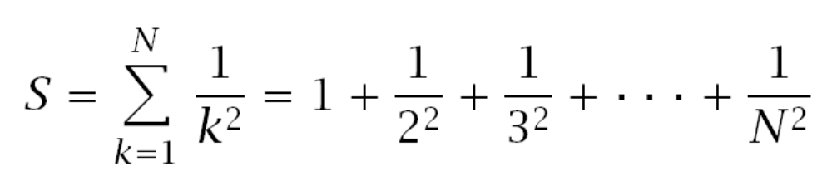
computation of sums with
for-loops, or while-loops
N=1000; S=0;
for k=1:N,
S = S + 1/k^2; % update partial sums
end
>> S % tends to pi^2/6 as N -> inf
S =
1.6439
k = 1:N; S = sum(1./k.^2) % vectorized version
S =
1.6439

Slide 34
if statements can contain for-loops
type = 'odd';
N = 1000; S = 0;
if strcmp(type,'even')
for k=2:2:N % sum over even k’s
S = S + 1/k^2;
end
elseif strcmp(type,'odd')
for k=1:2:N % sum over odd k’s
S = S + 1/k^2;
end
else
disp('type must be ''odd'' or ''even''');
end
>> S % odd case tends to pi^2/8
S = % even case tends to pi^2/24
1.2332

Slide 35
% double-loop example
N = 4; M = 3;
for i=1:N
for j=1:M
A(i,j) = i+j;
end
end
>> A
A =
2 3 4
3 4 5
4 5 6
5 6 7
nested for-loops

Slide 36
nested for-loops
% partially vectorized
% row-wise version
N=4; M=3; j=1:M;
for i=1:N
A(i,:) = i+j;
end
% partially vectorized
% column-wise version
N=4; M=3; i=1:N;
for j=1:M
A(:,j) = i+j;
end
% fully vectorized
% using meshgrid
N=4; M=3;
i=1:N; j=1:M;
[J,I]=meshgrid(j,i);
A = I+J;
why (j,i) instead of (i,j)?

Slide 37
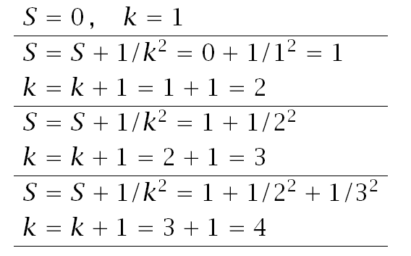
while - loops
while condition
statements ...
end
condition to
continue the loop
carry out a few iterations by hand
N=1000; S=0; k=1;
while k<=N,
S = S + 1/k^2;
k = k+1;
end
>> S,k
S =
1.6439
k =
1001
as N → ∞, sum converges to π²/6 = 1.6449...

Slide 38
while 1
statements ...
if condition
break;
end
statements ...
end
forever while - loops
condition to break out of the loop
N=1000; S=0; k=1;
while 1,
S = S + 1/k^2;
if k>N,
break;
end
k = k+1;
end
>> S,k
S = k =
1.6439 1000
Note: the continuation condition
of the conventional loop, and the
break condition of the equivalent
forever while loop are logical
complements of each other

Slide 39
break
terminates execution of a loop, and
continues after the end of the loop
terminates out of a nested loop only
break
continue
continue
stops present pass through a loop,
but continues with next pass

Slide 40
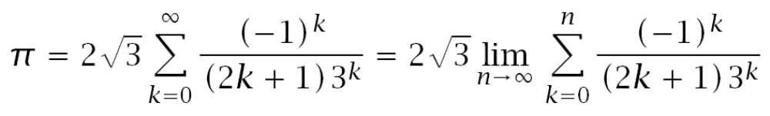
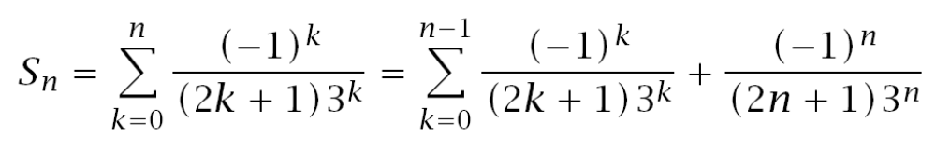
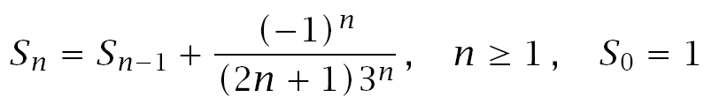
Example: Series calculations

Slide 41
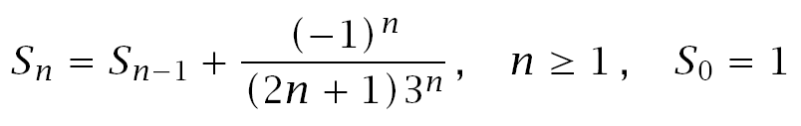
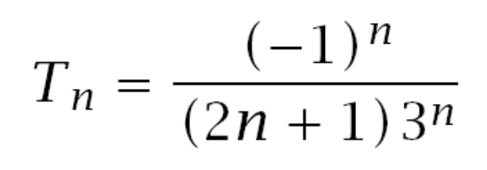
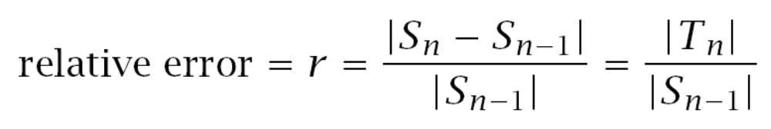
Recursion can be implemented with a for-loop or a while-loop

Slide 42
N = 10000; S = 1; % initialize
tol = 1e-14; % relative error
% try r = eps
for n=1:N,
T = (-1)^n /(2*n+1)/3^n; % n-th term
if abs(T) < tol % break out of
break; % the for-loop
end % if T is small
S = S + T; % update sum
end
n, [pi; 2*sqrt(3)*S] % compare with pi
n = % actual number
26 % of iterations
ans = % T = 7.4229e-015
3.141592653589793
3.141592653589774
for-loop

Slide 43
S = 0; T = 1; n = 0;
tol = 1e-14;
while abs(T) > tol
S = S + T;
n = n+1;
T = (-1)^n / (2*n+1) / 3^n;
end
n, [pi; 2*sqrt(3)*S] % compare with pi
n =
26
ans = % T = 7.4229e-015
3.141592653589793
3.141592653589774
while-loop

Slide 44
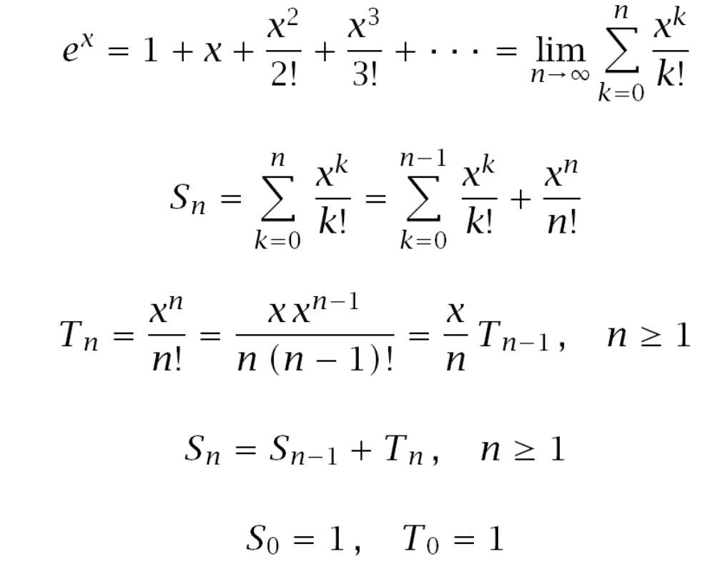
Example: Vectorized Taylor series calculations

Slide 45
% version 1 – using a for-loop
x = [1 3 0 -4 10]'; % column vector
S = ones(size(x)); % inherits size of x
T = 1;
N = 10000; % max iterations
tol = 1e-12; % error tolerance
for n=1:N,
T = T.*x/n; % n-th term
if max(abs(T)) < tol % break if |T|<tol
break; % why max(abs(T))?
end
S = S + T; % update sum
end

Slide 46
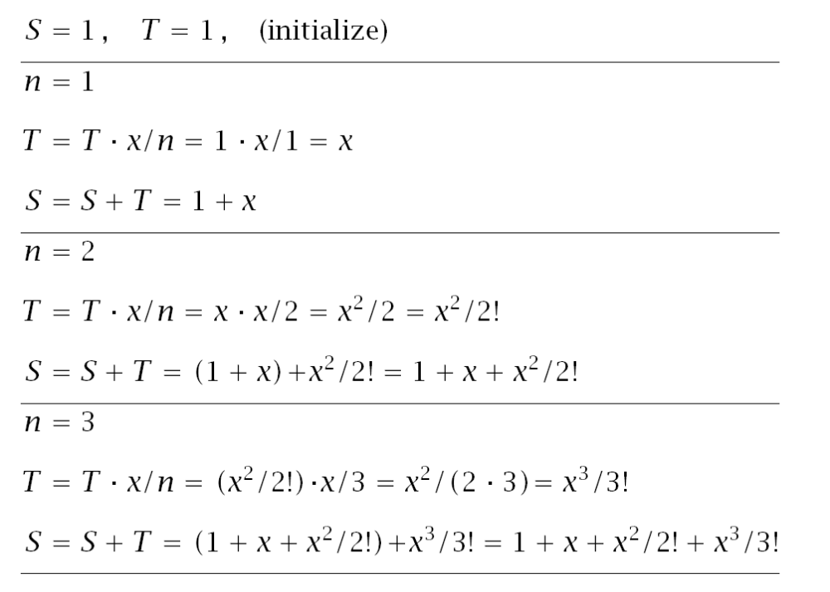
always carry out some
iterations by hand

Slide 47
fprintf(' x exp(x) S\n');
fprintf('------------------------------------\n');
fprintf('% 7.2f %12.6f %12.6f\n', [x,exp(x),S]');
fprintf('------------------------------------\n');
fprintf(['iterations n = ',int2str(n),'\n']);
x exp(x) S
------------------------------------
1.00 2.718282 2.718282
3.00 20.085537 20.085537
0.00 1.000000 1.000000
-4.00 0.018316 0.018316
10.00 22026.465795 22026.465795
------------------------------------
iterations n = 47
% norm(S-exp(x)) % equals 7.2760e-012

Slide 48
% version 2 – using a while-loop
x = [1 3 0 -4 10]'; % column vector
S = ones(size(x)); % inherits size of x
T = 1; n=1; % initialize
tol = 1e-12; % error tolerance
while max(abs(T)) > tol % can also use
T = x.*T/n; % norm(T)>tol
S = S+T;
n = n+1;
end

Slide 49
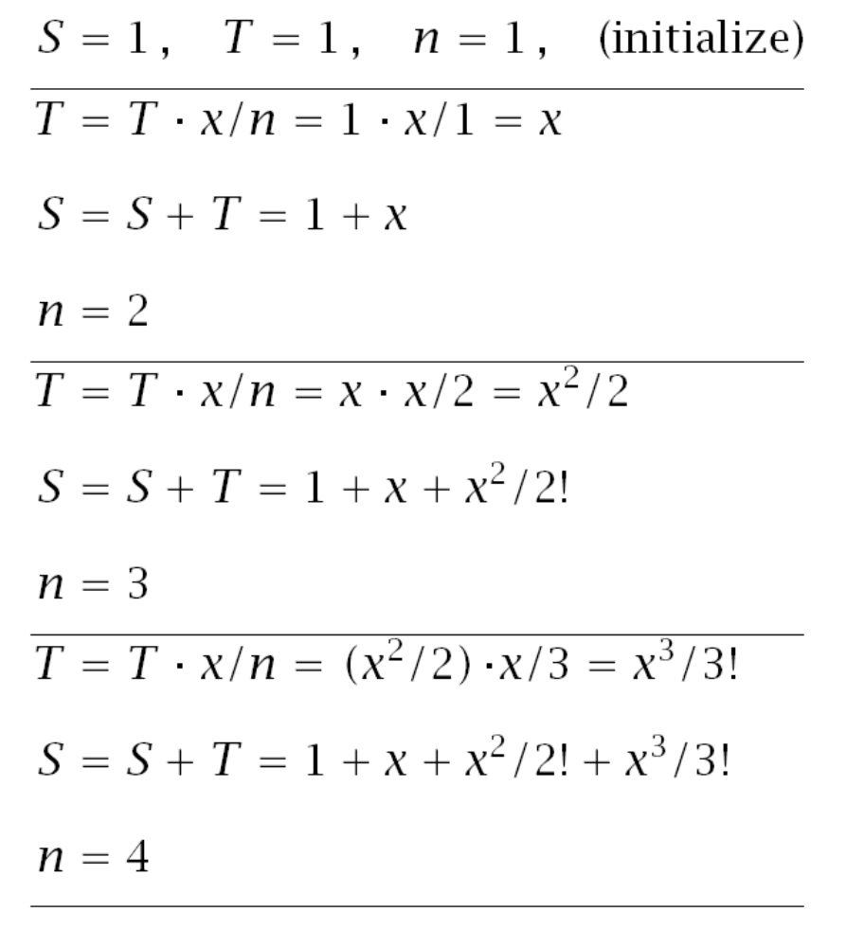
always carry out some
iterations by hand

Slide 50
fprintf(' x exp(x) S\n');
fprintf('------------------------------------\n');
fprintf('% 7.2f %12.6f %12.6f\n', [x,exp(x),S]');
fprintf('------------------------------------\n');
fprintf(['iterations n = ',int2str(n-1),'\n']);
x exp(x) S
------------------------------------
1.00 2.718282 2.718282
3.00 20.085537 20.085537
0.00 1.000000 1.000000
-4.00 0.018316 0.018316
10.00 22026.465795 22026.465795
------------------------------------
iterations n = 47
why n-1?

Slide 51
% version 3 – using a forever while-loop
x = [1 3 0 -4 10]'; % column vector
S = ones(size(x)); % inherits size of x
T = 1; n=1; % initialize
tol = 1e-12; % error tolerance
while 1 % forever loop
T = x.*T/n;
if max(abs(T)) < tol
break;
end
S = S+T;
n = n+1;
end

Slide 52
fprintf(' x exp(x) S\n');
fprintf('------------------------------------\n');
fprintf('% 7.2f %12.6f %12.6f\n', [x,exp(x),S]');
fprintf('------------------------------------\n');
fprintf(['iterations n = ',int2str(n),'\n']);
x exp(x) S
------------------------------------
1.00 2.718282 2.718282
3.00 20.085537 20.085537
0.00 1.000000 1.000000
-4.00 0.018316 0.018316
10.00 22026.465795 22026.465795
------------------------------------
iterations n = 47

Slide 53
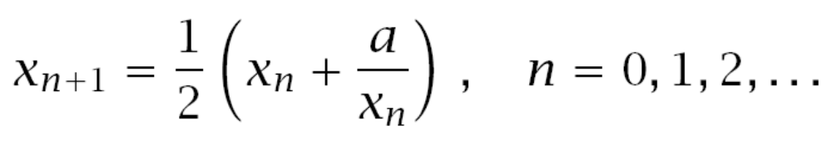

Example: Square-root algorithm
a = 20; % sqrt(a) = 4.472135954999580
N = 10;
x(1) = 8; % arbitrary initial value
for n=1:N-1,
x(n+1) = (x(n) + a/x(n))/2;
end

Slide 54
fprintf(' n x \n');
fprintf('----------------------\n');
fprintf('%3.0f %17.15f\n', [1:N; x]);
n x
----------------------
1 8.000000000000000
2 5.250000000000000
3 4.529761904761905
4 4.472502502972279
5 4.472135970019965
6 4.472135954999580
7 4.472135954999580
8 4.472135954999580
9 4.472135954999580
10 4.472135954999580
converged in
6 iterations

Slide 55
a = 20; N = 10; x(1) = 8; % initialize
tol = 1e-12; % our choice
fprintf(' n x(n) \n');
fprintf('----------------------\n');
for n=1:N-1,
fprintf('%2.0f %17.15f\n', n,x(n));
if abs(x(n)^2-a) <= tol
break;
end
x(n+1) = (x(n) + a/x(n))/2;
end
break out of the
loop if converged
to within the error
tolerance, tol
(output in next page)

Slide 56
n x(n)
----------------------
1 8.000000000000000
2 5.250000000000000
3 4.529761904761905
4 4.472502502972279
5 4.472135970019965
6 4.472135954999580
converged in
6 iterations
exactly the same output is obtained
using a while-loop in the next page

Slide 57
a = 20; n = 1; x = 8; tol = 1e-12;
fprintf(' n x error\n');
fprintf('---------------------------------\n');
while abs(x^2-a) > tol
x = (x + a/x)/2;
n = n+1;
E = abs(x^2-a);
fprintf(' %1d %17.15f %8.2e\n', n,x,E);
end
conventional while-loop
n x error
---------------------------------
2 5.250000000000000 7.56e+00
3 4.529761904761905 5.19e-01
4 4.472502502972279 3.28e-03
5 4.472135970019965 1.34e-07
6 4.472135954999580 3.55e-15
final error
E = |x² - a|
is smaller than
tol

Slide 58
a = 20; x = 8; n = 1; tol = 1e-12;
fprintf(' n x error\n');
fprintf('---------------------------------\n');
while 1
if abs(x^2-a) <= tol, break; end
x = (x + a/x)/2;
n = n+1;
E = abs(x^2-a);
fprintf(' %1d %17.15f %8.2e\n', n,x,E);
end
forever
while-loop
n x error
---------------------------------
2 5.250000000000000 7.56e+00
3 4.529761904761905 5.19e-01
4 4.472502502972279 3.28e-03
5 4.472135970019965 1.34e-07
6 4.472135954999580 3.55e-15

Slide 59
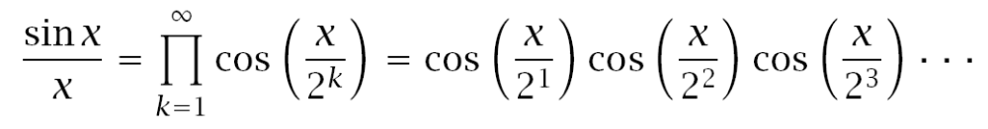
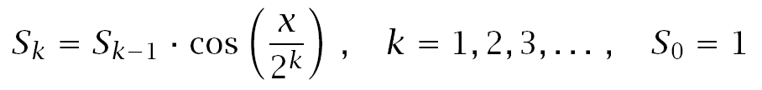
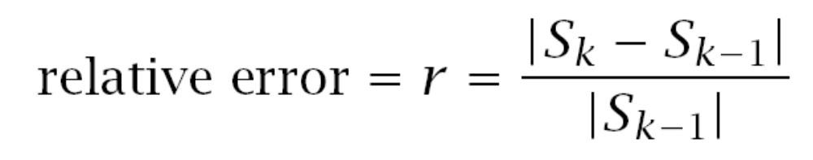
Example: Calculating Products

Slide 60
x = [0.1, 0.2, 1, 4, 8]'; % column vector
S = ones(size(x)); % inherits size of x
k=1;
r = 1e-10; % relative error
while 1 % forever loop
F = cos(x/2^k); % k-th factor
S1 = S.*F;
if norm(S1-S) < r*norm(S)
break;
end
S = S1;
k = k+1;
end
use vector norm to measure the
distance between S and S1

Slide 61
fprintf(' x sin(x)/x S\n');
fprintf('----------------------------------\n');
fprintf('%6.2f %12.6f %12.6f\n', [x, sin(x)./x,S]');
fprintf('----------------------------------\n');
fprintf(['iterations k = ',int2str(k),'\n']);
x sin(x)/x S
----------------------------------
0.10 0.998334 0.998334
0.20 0.993347 0.993347
1.00 0.841471 0.841471
4.00 -0.189201 -0.189201
8.00 0.123670 0.123670
----------------------------------
iterations k = 18

Slide 62
Example: Overlapping Echoes
a simple example of a Digital Audio Effect
reads a wave file and plays a 20-sec portion of it
then, adds three overlapping copies of itself and plays the result
illustrates the use of for-loops, if-statements, and pre-allocation to speed up processing
complete program, echoes.m, and supporting
wave files are in the zip file, echoes.zip,
(under week-2 and week-7 resources on sakai)

Slide 63
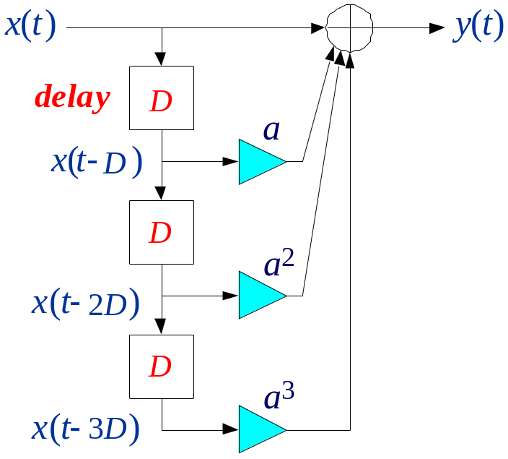
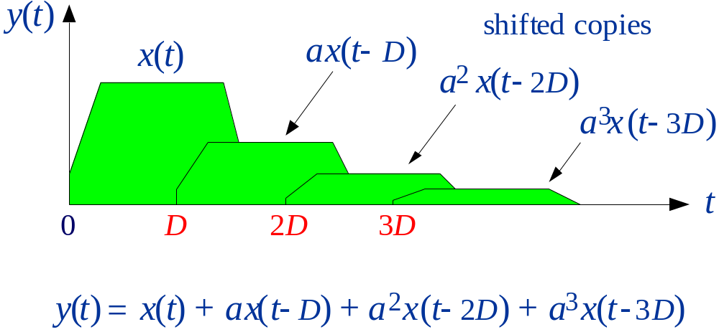
block-diagram realization

Slide 64
% echoes.m – listening to overlapping echoes
clear all;
[x,Fs] = wavread('dsummer.wav'); % read wave file and Fs
N = min(round(20*Fs),length(x)); % play no more than 20 sec
x = x(1:N); % truncate x to length N
sound(x,Fs); % play x
T = 1/2; D = round(T*Fs); % echo delay in sec and in samples
Fs, N, D % here, Fs=44100, N=839242, D=22050
a = 0.5; % multiplier coefficient
y = zeros(size(x)); % pre-allocation speeds up processing

Slide 65
tic % tic-toc - execution time
for n=1:length(x), % construct overlapped signal y
if n<=D,
y(n) = x(n);
elseif n<=2*D,
y(n) = x(n) + a * x(n-D);
elseif n<=3*D,
y(n) = x(n) + a * x(n-D) + a^2 * x(n-2*D);
else,
y(n) = x(n) + a * x(n-D) + a^2 * x(n-2*D) +...
a^3 * x(n-3*D);
end
end
toc
pause; sound(y,Fs); % play overlapped signal y
if-elseif statements
within a for-loop

Slide 66
pre-allocation results
wave file Fs N with without
JB.wav 16000 71472 0.02 sec 0.06 sec
nodelay.wav 22050 266758 0.10 sec 0.30 sec
dsummer.wav 44100 839242 0.30 sec 0.90 sec

