Slide 1
SECP 2733
Matlab
User Defined Functions
Mohsin Mohd Sies
School of Chemical and Energy Engineering
Major credits to
Professor Sophocles Orfanidis
Rutgers University

Slide 2
User-Defined Functions
M-files, script files, function files
anonymous & inline functions
function handles
function functions, fzero,fminbnd
multiple inputs & outputs
subfunctions, nested functions
homework template function
function types
recursive functions, fractals

Slide 3
M-files: script files and function files
Script M-files contain commands to be executed as though they were typed into the command window, i.e., they collect many commands together into a single file.
Function M-files must start with a function definition line, and may accept input variables and/or return output variables.
The function definition line has syntax:
function [outputs] = func(inputs)
where the function name, func, is arbitrary and must match the name of the M-file, i.e., func.m

Slide 4
Variables defined in a script M-file are known to the whole current workspace, i.e., inside and outside the script file.
Script M-files may not have any function definitions in them, unless the functions are defined as inline or anonymous one-line functions, e.g., using the function-handle @(x).
Variables in a function M-file are local to that function only and are not recognized outside the function (unless they are declared as global variables, which is usually not recommended.)
Function files may include the definition of other functions, either as sub-functions, or as nested functions. This helps to collect together all relevant functions into a single file (e.g., this is how you may structure your homework solutions.)

Slide 5
Example:
% file rms.m calculates the
% root-mean-square (RMS) value and the
% mean-absolute value of a vector x:
function [r,m] = rms(x)
r = sqrt(sum(abs(x).^2) / length(x));
m = sum(abs(x)) / length(x);
>> x = -4:4;
>> [r,m] = rms(x)
r =
2.5820
m =
2.2222
>> r = rms(x);
returns only the first output
returns only the second output
>> [~,m] = rms(x);

Slide 6
Function Names
Function filename rms.m must be the same as the function name in the function declaration line
function [r,m] = rms(x)
Function name appears three times :
Function filename
Function name in function declaration line
When called/invoked in the main script
% file rms.m calculates the
% root-mean-square (RMS) value and the
% mean-absolute value of a vector x:
function [r,m] = rms(x)
r = sqrt(sum(abs(x).^2) / length(x));
m = sum(abs(x)) / length(x);
>> x = -4:4;
>> [r,m] = rms(x)
r =
2.5820
m =
2.2222

Slide 7
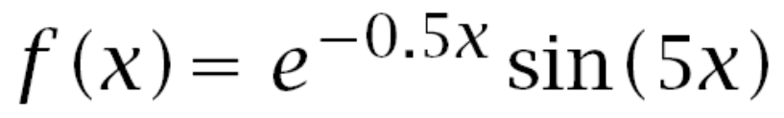
Make up your own functions using these methods:
1. anonymous, with function-handle, @(x)
2. M-file
example 1:
>> f = @(x) exp(-0.5*x).*sin(5*x);
>> g = inline('exp(-0.5*x).*sin(5*x)');
% edit & save file h.m containing the lines:
function y = h(x)
y = exp(-0.5*x).*sin(5*x);
.* allows vector or matrix inputs x

Slide 8

How to include parameters in functions
example 2:
% method 1: define a,b first, then define f
a = 0.5; b = 5;
f = @(x) exp(-a*x).*sin(b*x);
% method 2: pass parameters as arguments to f
f = @(x,a,b) exp(-a*x).*sin(b*x);
% this defines the function f(x,a,b)
% so that f(x, 0.5, 5) would be equivalent to
% the f(x) defined in method 1.

Slide 9
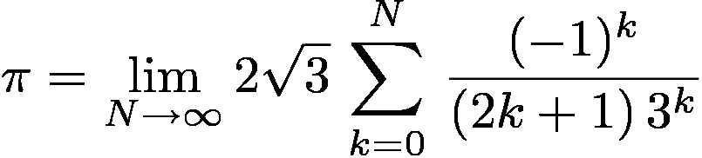
example 3: test the convergence of the following
series for π , (Madhava, ca.1400):
g = @(N) 2*sqrt(3) * cumsum(...
(-1).^(0:N)./(2*(0:N)+1)./3.^(0:N));
% edit & save file f.m containing the lines:
function y = f(N)
k=0:N;
y = 2*sqrt(3)*cumsum((-1).^k./(2*k+1)./3.^k);

Slide 10
convergence results:
N f(N) or g(N) digit accuracy
--------------------------------------
5 3.141 3
10 3.14159 5
15 3.14159265 8
20 3.1415926535 10
25 3.1415926535897 13
Inf 3.1415926535897...
Note: the functions f(N) and g(N) give equivalent results,
g(N) is a one-line definition, but much harder to read,
f(N) is easy to read, but requires its own M-file, here, f.m

Slide 11
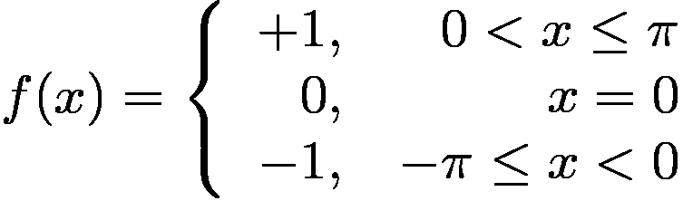
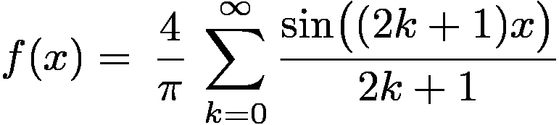
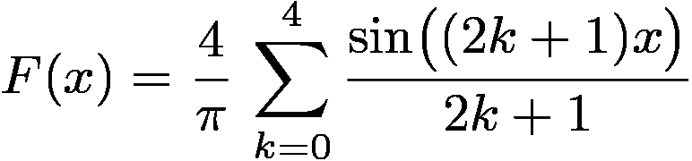
example 4: Fourier series approximation of the function,
keep only the k=0:4 terms, define the function F(x), and compute and plot both f(x) and F(x)

Slide 12
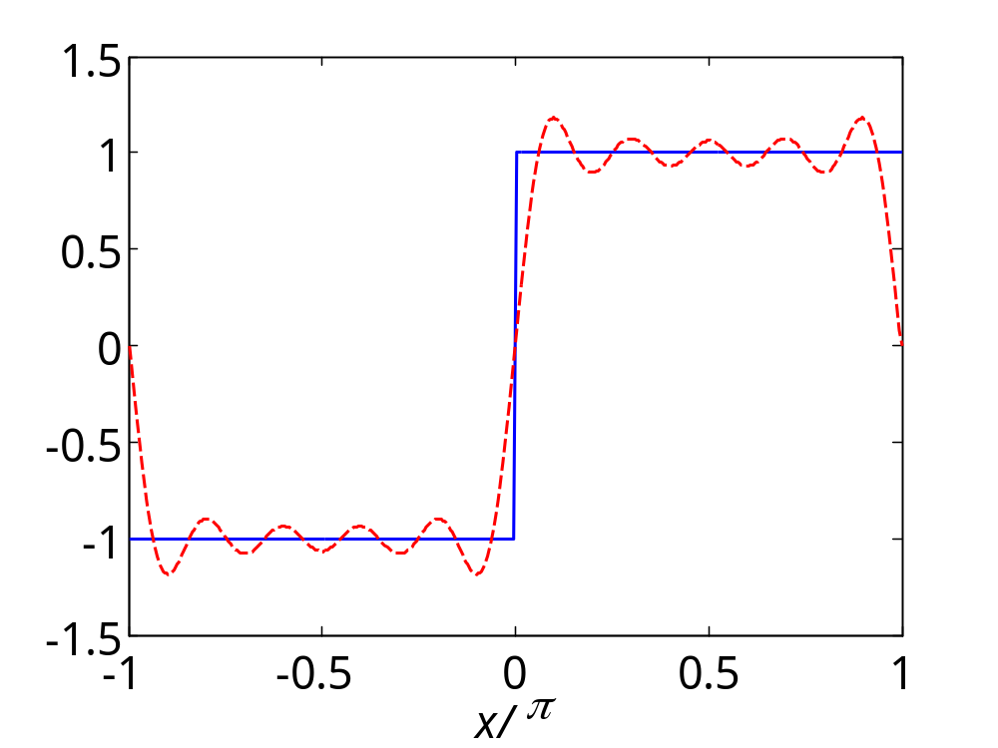
>> f = @(x) sign(x) .* (abs(x)<=pi);
>> F = @(x) 4/pi*( sin(x) + sin(3*x)/3 + ...
sin(5*x)/5 + sin(7*x)/7 + sin(9*x)/9 );
>> x = linspace(-pi,pi,501);
>> plot(x/pi,f(x),'b-', x/pi,F(x),'r--');
>> xlabel('\itx/\pi');
Note: when x is a vector,
the logical statement
(abs(x)<=pi)
results in a vector of 0s or 1s,
see the section on relational
and logical operators, in week-7 lecture notes

Slide 13
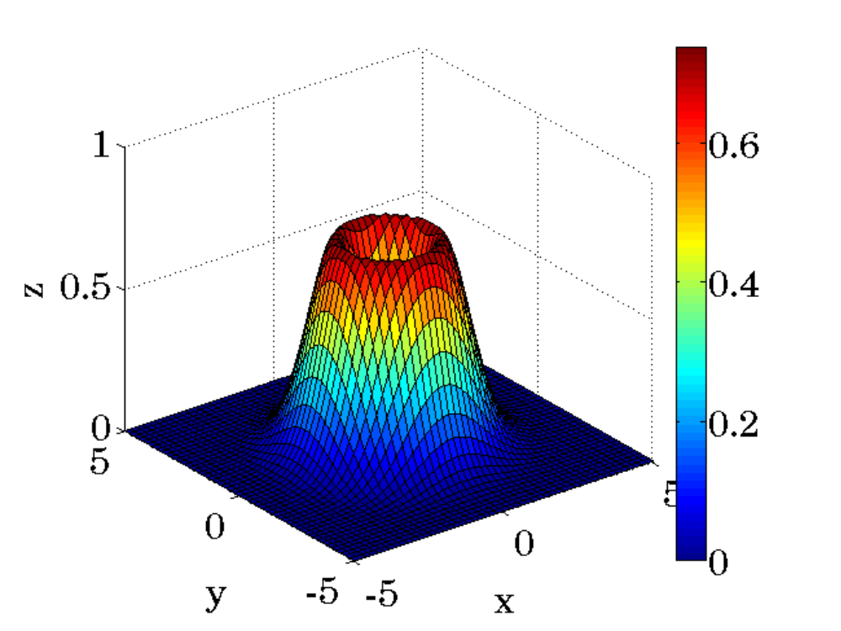
example 5: Anonymous functions with multiple arguments
f = @(x,y) (x.^2 + y.^2) .* exp(-(x.^2 + y.^2)/2);
x = linspace(-5,5,51);
y = linspace(-5,5,51);
[X,Y] = meshgrid(x,y);
Z = f(X,Y);
surf(X,Y,Z);
colorbar;

Slide 14
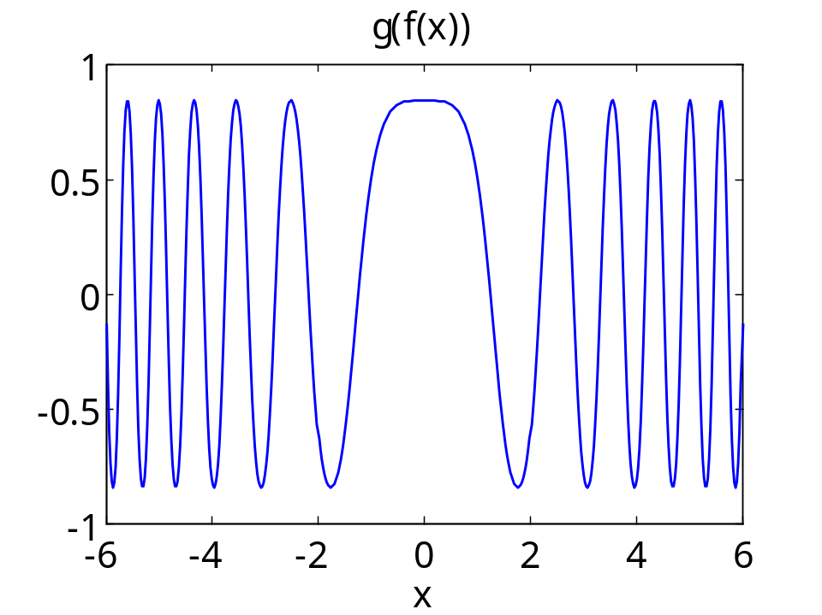
Anonymous functions can be nested
>> f = @(x) x.^2;
>> g = @(x) sin(cos(x));
>> h = @(x) g(f(x)); % i.e., sin(cos(x.^2))
>> fplot(h,[-6,6],'b-');
>> xlabel('x'); title('g(f(x))');

Slide 15
Function Handles
A function handle is a data type that allows the referencing and evaluation of a function, as well as passing the function as an input to other functions, e.g., to fplot, ezplot, fzero, fminbnd, fminsearch.
In anonymous functions, e.g., f = @(x) (expression)
the defined quantity f is already a function handle.
For built-in, or user-defined functions in M-files, the function
handle is obtained by prepending the character @ in front of the function name, e.g.,
f_handle = @sin;
f_handle = @my_function;

Slide 16
Function Functions
>> help funfun
A number of MATLAB functions accept other functions as
arguments. Such functions cover the following categories:
Function optimization (min/maximization) , root finding, and plotting, and data fitting, e.g., fplot, ezplot, fzero, fminbnd, fminsearch, nlinfit, lsqcurvefit.
2. Numerical integration (quadrature) , e.g., quad, and its variants.
3. Differential equation solvers, e.g., ode45, and others.
4. Initial value and boundary value problem solvers.
The function argument is passed either as a function handle
(new method), or, as a string of the function name (old method)

Slide 17
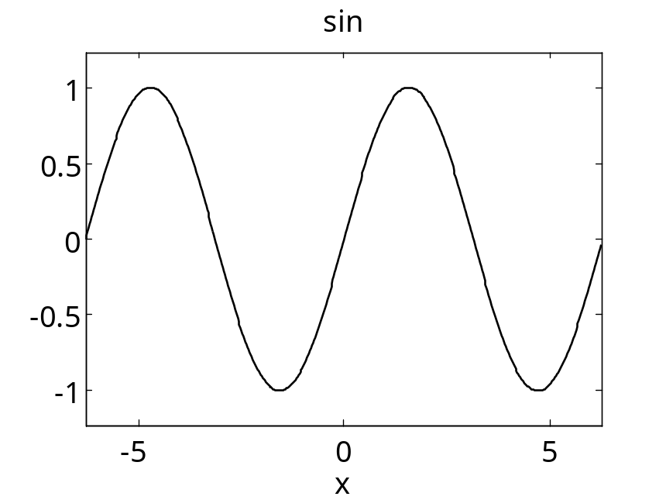
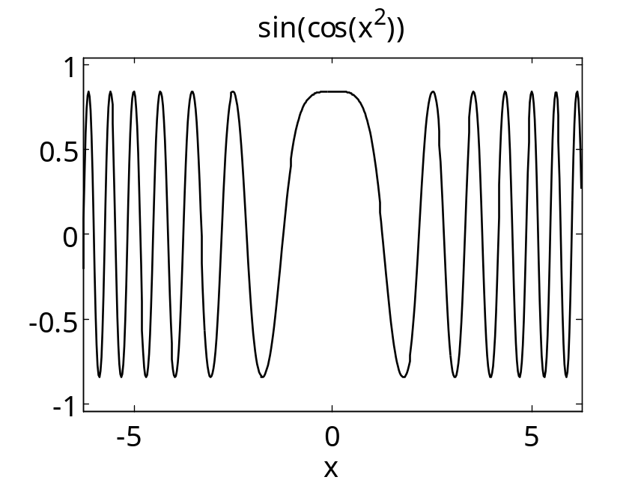
>> ezplot(@sin); % pass by function handle
>> ezplot('sin'); % older method
>> ezplot('sin(x)');
>> f = @(x) sin(cos(x.^2));
>> ezplot(f); % equivalent
>> ezplot(@(x) sin(cos(x.^2))); % methods
>> ezplot(@(x) sin(cos(x^2)));
>> ezplot('sin(cos(x^2))');

Slide 18
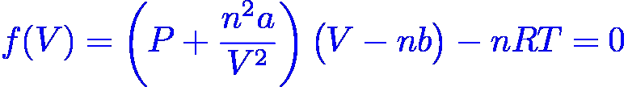
Solution of the Van der Waals equation using fzero
P = 220; n = 2; % values are from
a = 5.536; b = 0.03049; % Problem 2.7
R = 0.08314472; T = 1000;
V0 = n*R*T/P; % ideal-gas case, V0 = 0.7559
f = @(V) (P + n^2*a./V.^2).*(V-n*b) - n*R*T;
V = fzero(f, V0)
V =
0.6825
seek a solution of f(V) = 0, near V0

Slide 19
passing to fzero a function that has additional parameters
f = @(x,a,b) ... % define f(x,a,b) here,
% or, in a separate M-file
% find the solution of f(x,a,b)=0
% define a,b here
x = fzero(@(x) f(x,a,b), x0);
effectively defines a new anonymous function and passes its handle to fzero
same method can be
used for fminbnd,
and all other function functions
>> doc fzero

Slide 20
Example 1
P = 220; n = 2; % values are from
a = 5.536; b = 0.03049; % Problem 2.7
R = 0.08314472; T = 1000;
V0 = n*R*T/P; % ideal-gas case, V0=0.7559
f=@(V,a,b) (P + n^2*a./V.^2).*(V-n*b) - n*R*T;
V = fzero(@(V) f(V,a,b), V0)
V =
0.6825
defines a new anonymous function and passes its handle to fzero

Slide 21
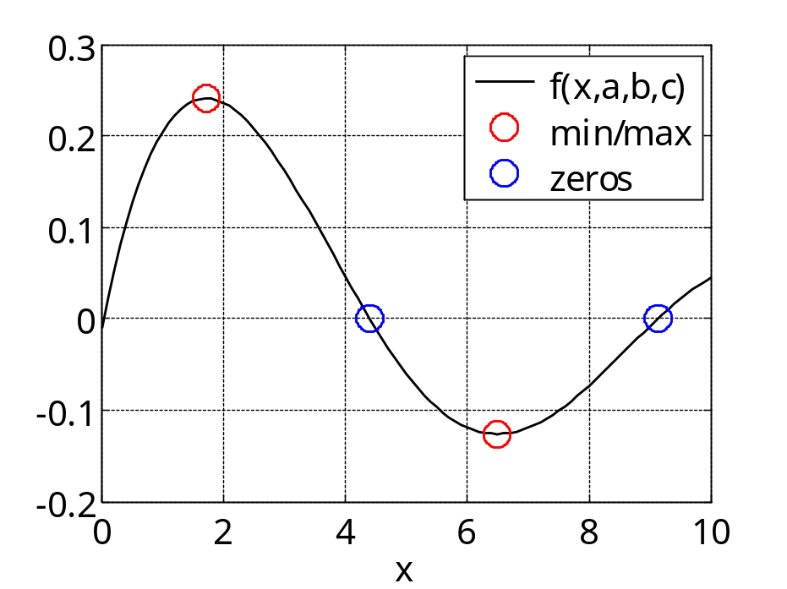
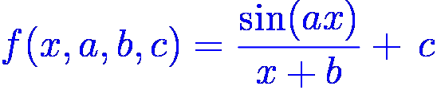
f = @(x,a,b,c) sin(a*x)./(x + b) + c;
a = 0.7; b = 2; c = -0.01;
[x1,f1] = fminbnd(@(x) -f(x,a,b,c), 0,4); f1 = -f1;
[x2,f2] = fminbnd(@(x) f(x,a,b,c), 6,8);
x3 = fzero(@(x) f(x,a,b,c), 5);
x4 = fzero(@(x) f(x,a,b,c), 9);
x = linspace(0,10,101);
y = f(x,a,b,c);
plot(x,y, [x1,x2],[f1,f2],'ro',[x3,x4],[0,0],'bo');
Example 2

Slide 22
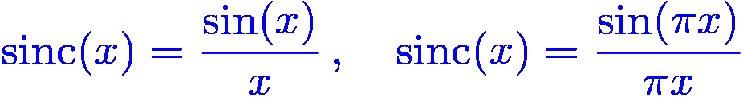
sinc functions appear in many engineering applications:
Fourier analysis of signals
Optical systems (resolving power of microscopes, telescopes)
Radar systems
DSP applications and digital communications
Antenna arrays, sonar and seismic arrays
Playback systems of CD and MP3 players (known as sinc interpolation filters or oversampling digital filters)
And many others
math
definition
MATLAB
definition

Slide 23
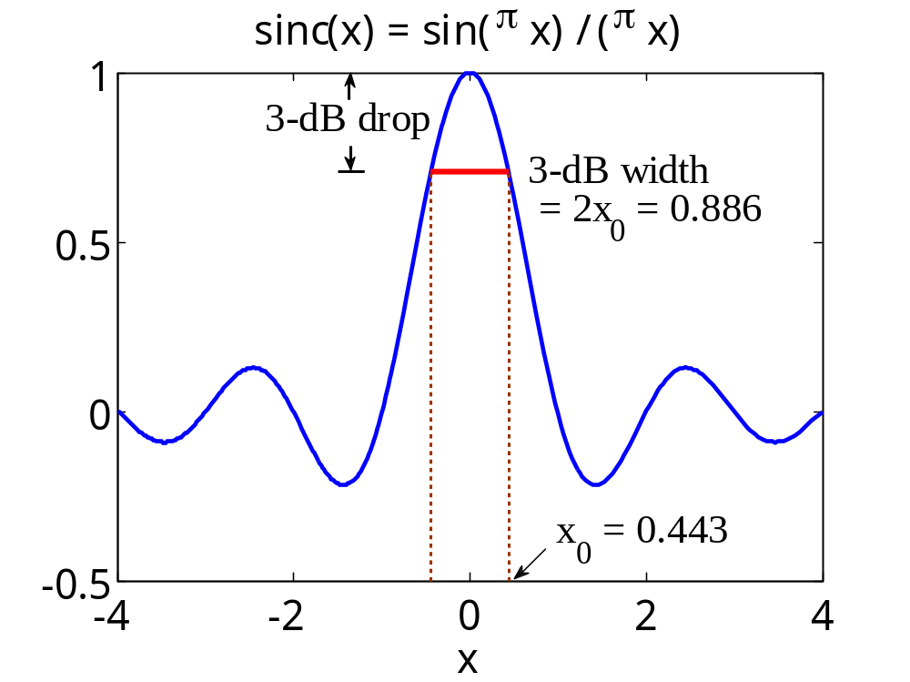
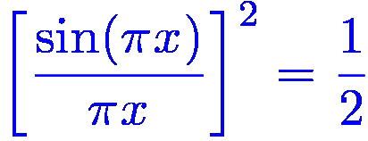
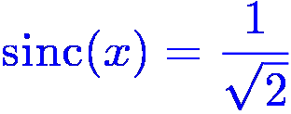

Example 3 - 3-dB width of the sinc function
fplot(@sinc, [-4,4], 'b-'); hold on;
f = @(x) sinc(x)-1/sqrt(2);
x0 = fzero(f,0.5); % x0 = 0.443
plot([-x0,x0],[1,1]/sqrt(2),'r-');
x0 is the solution
of the equation:
or,

Slide 24
Multi-Input Multi-Output Functions
In general, a function can accept several variables as input arguments and produce several variables as outputs.
The input arguments are separated by commas, and the output variables are listed within brackets, and can have different sizes and types:
[out1, out2, ...] = funct(in1, in2,...)
The number of input and output variables are counted by the reserved variables: nargin, nargout
Functions can also have a variable number of inputs and outputs controlled by: varargin, varargout

Slide 25
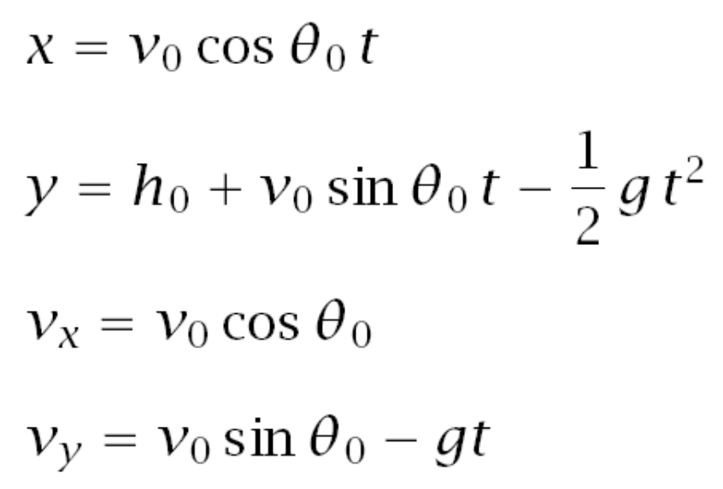
Example: calculate the x,y coordinates and x,y velocities vx,vy of a projectile, at a vector of times t, launched from height h0 with initial velocity v0, at angle θ0 (in degrees) from the horizontal, under vertical acceleration of gravity g:
[x,y,vx,vy] = trajectory(t,v0,th0,h0,g);
The equations of motion are:
The function trajectory should have the following possible ways of calling it:

Slide 26
[x,y,vx,vy] = trajectory(t,v0);
[x,y,vx,vy] = trajectory(t,v0,th0);
[x,y,vx,vy] = trajectory(t,v0,th0,h0);
[x,y,vx,vy] = trajectory(t,v0,th0,h0,g);
[~,y,~,vy] = trajectory(t,v0,th0,h0,g);
x = trajectory(t,v0,th0,h0);
[x,y] = trajectory(t,v0,th0,h0);
[x,y,vx] = trajectory(t,v0,th0,h0);
where, if omitted, the default input values should be:
th0 = 90; % vertical launch, degrees
h0 = 0; % ground level
g = 9.81; % m/sec^2
only the listed output variables are returned
place-holders for unused output arguments

Slide 27
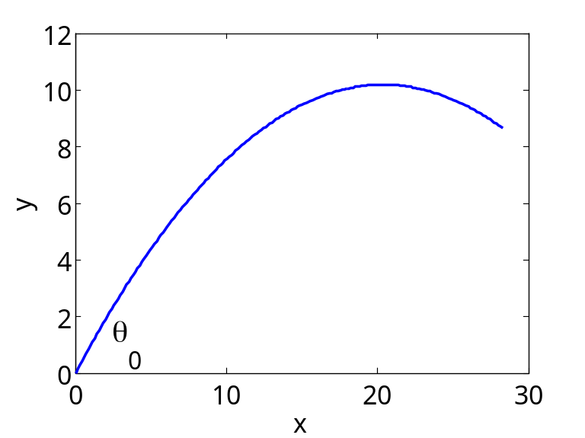
function [x,y,vx,vy] = trajectory(t,v0,th0,h0,g)
if nargin<=4, g = 9.81; end % default values
if nargin<=3, h0 = 0; end
if nargin==2, th0 = 90; end
th0 = th0 * pi/180; % convert th0 to radians
x = v0*cos(th0)*t;
y = h0 + v0*sin(th0)*t - 1/2*g*t.^2;
vx = v0*cos(th0);
vy = v0*sin(th0) - g*t;
t = linspace(0,2,201);
v0 = 20; th0 = 45;
[x,y]=trajectory(t,v0,th0);
plot(x,y, 'b');
xlabel('x'); ylabel('y');

Slide 28
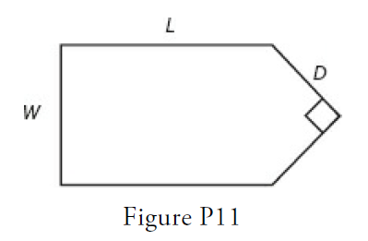
Example
A fence around a field is shaped as shown in Figure P11. It consists of a rectangle of length L and width W, and a right triangle that is symmetrical about the central horizontal axis of the rectangle. Suppose the width W is known (in meters) and the enclosed area A is known (in square meters). Write a user-defined function file with W and A as inputs. The outputs are the length L required so that the enclosed area is A and the total length of fence required. Test your function for the values W = 6 m and A = 80 m2.

Slide 29
Subfunctions and Nested Functions
A function can include, at its end, the definitions of other functions, referred to as subfunctions.
The subfunctions can appear in any order and each can be called by any of the other ones within the primary function.
Each subfunction has its own workspace variables that are not shared by the other subfunctions or the primary one, i.e., each subfunction communicates only through its output variables.
Nested functions share their workspace variables with those of the primary function. They must all end with the keyword end, i.e., if an end is used in one, it must used also in all the others.

Slide 30
Example:
% alternative version of rms.m
function [r,m] = rms(x)
r = rmsq(x); % root-mean-square
m = mav(x); % mean absolute value
function y = rmsq(x)
y = sqrt(sum(abs(x).^2) / length(x));
function y = mav(x)
y = sum(abs(x)) / length(x);
the appearance of the keyword function
signals the beginning of each subfunction

Slide 31
Example:
% nested version of rms.m
function [r,m] = rms(x)
N = length(x);
r = rmsq(x); % root-mean-square
m = mav(x); % mean absolute value
function y = rmsq(x)
y = sqrt(sum(abs(x).^2)/N);
end % end of rmsq
function y = mav(x)
y = sum(abs(x))/N;
end % end of mav
end % end of rms
N is known to the
nested subfunctions

Slide 32
Example: recommended structure for homework reports
function set1
problem1
problem2
problem3
function problem1
...
function problem2
...
function problem3
...
function other1
...
function other2
...
function other3
...
primary function
execute problem subfunctions
to get the homework results
define the subfunctions
implementing each problem
define the problem subfunctions
implementing each problem
define any other subfunctions
that may be called by the
problem subfunctions

Slide 33
Summary of Function Types
Primary functions
Anonymous functions
Subfunctions
Nested functions
Private functions
Overloaded functions
Recursive functions

Slide 34
Recursive Functions
Recursive functions call themselves
i.e., they define themselves by calling themselves
Not quite as circular as it sounds
(e.g., a tall person is defined as one who is tall)
Interesting and elegant programming concept,
but tends to be very slow in execution (it exists in other
languages like C/C++ and Java )
Nicely suited for repetitive tasks, like generating fractals

Slide 35
Example 1: Fibonacci numbers, f(n) = f(n-1) + f(n-2)
function y = fib(n,c)
if n==1, y = c(1); end
if n==2, y = c(2); end
if n>=3,
y = fib(n-1,c) + fib(n-2,c);
end
initial values:
f(1) = c(1);
f(2) = c(2);
c = [c(1),c(2)];
y = []; c = [0,1];
for n=1:10,
y = [y, fib(n,c)];
end
y =
0 1 1 2 3 5 8 13 21 34

Slide 36
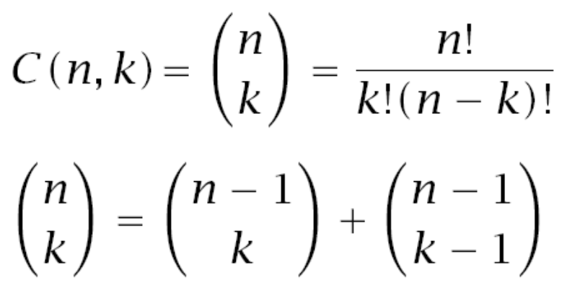
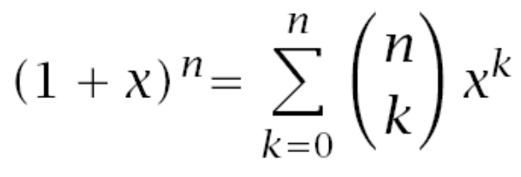
Example 2: Binomial Coefficients, nchoosek(n,k)
function C = bincoeff(n,k)
if (k==0)|(k==n), % assumes n>=0, k>=0
C = 1;
elseif k>n,
C = 0;
else
C = bincoeff(n-1,k) + bincoeff(n-1,k-1);
end

Slide 37
for n=0:6,
C=[];
for k=0:n,
C = [C, bincoeff(n,k)];
end
disp(C);
end
1
1 1
1 2 1
1 3 3 1
1 4 6 4 1
1 5 10 10 5 1
1 6 15 20 15 6 1
Pascal triangle

Slide 38

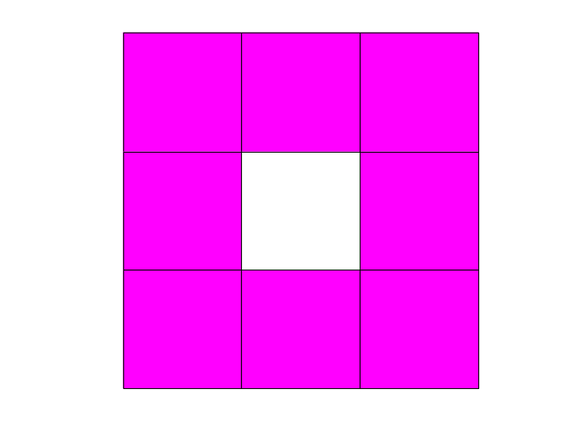
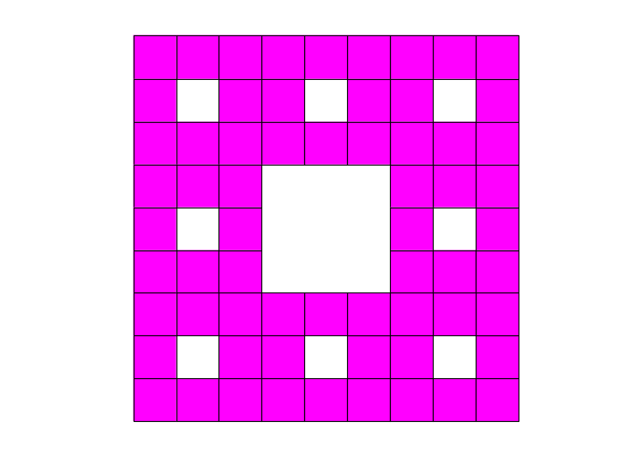
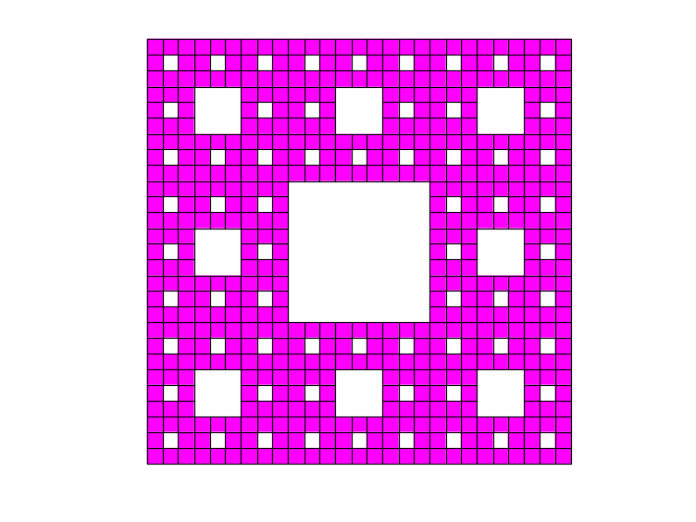
Example 3: Sierpinsky Carpet
level = 0
level = 1
level = 2
level = 3

Slide 39
level=2;
a=[0,0]; b=[1,0]; c=[1,1]; d=[0,1];
carpet(a,b,c,d,level);
axis equal; axis off;
d
c
a
b

Slide 40
d
u
t
c
function carpet(a,b,c,d,level)
p = (2*a+b)/3; q = (a+2*b)/3;
r = (2*b+c)/3; s = (b+2*c)/3;
t = (d+2*c)/3; u = (2*d+c)/3;
v = (2*d+a)/3; w = (d+2*a)/3;
e = (2*w+r)/3; f = (w + 2*r)/3;
g = (2*s+v)/3; h = (s + 2*v)/3;
if level==0,
fill([a(1),b(1),c(1),d(1)], [a(2),b(2),c(2),d(2)], 'm');
hold on;
else
carpet(a,p,e,w, level-1); % recursive calls
carpet(p,q,f,e, level-1);
carpet(q,b,r,f, level-1);
carpet(f,r,s,g, level-1);
carpet(g,s,c,t, level-1);
carpet(h,g,t,u, level-1);
carpet(v,h,u,d, level-1);
carpet(w,e,h,v, level-1);
end
v
g
s
h
w
e
f
r
a
p
q
b
carpet.m

Slide 41
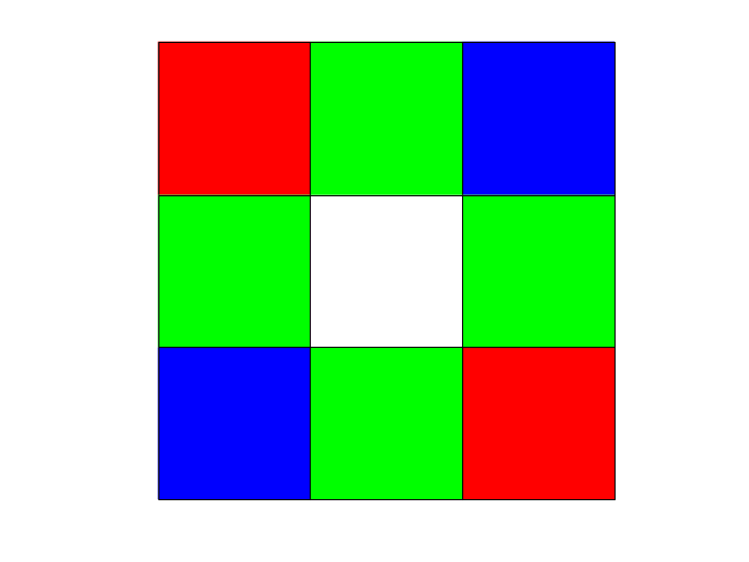
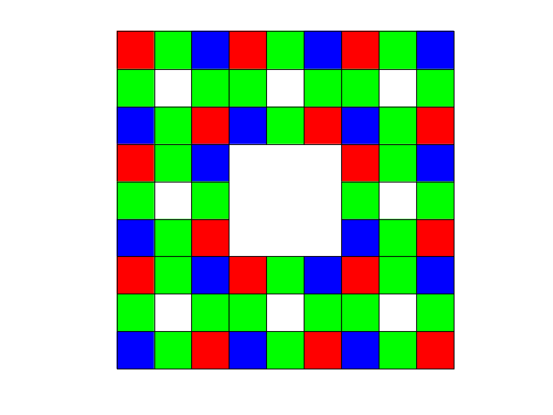

see, carpet2.m

Slide 42
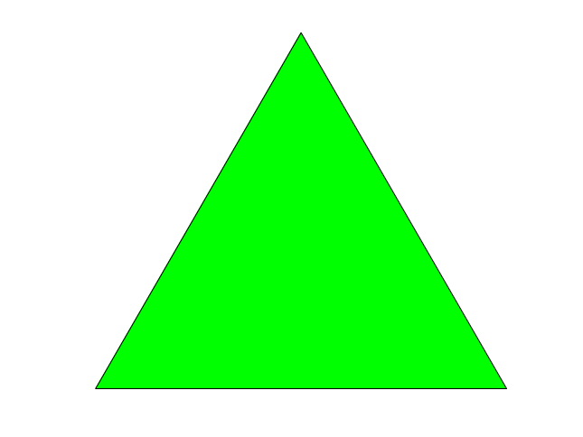
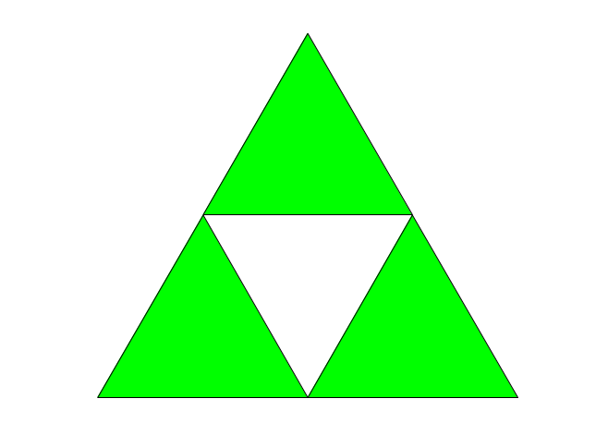
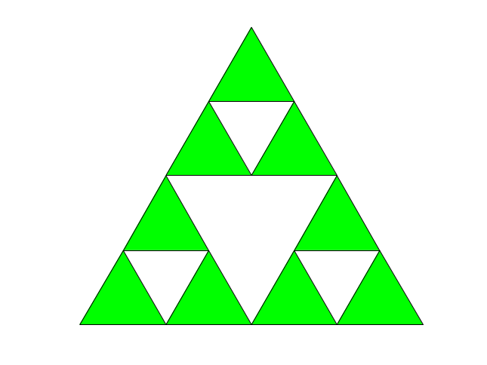



Example 4:
Sierpinsky Gasket
gasket.m
0
level 1
level 2
3
4
5

Slide 43
c
function gasket(a,b,c,level)
u = (a+b)/2;
v = (b+c)/2;
w = (c+a)/2;
if level==0,
fill([a(1),b(1),c(1)], [a(2),b(2),c(2)], 'g');
hold on;
else
gasket(a,u,w, level-1);
gasket(u,b,v, level-1);
gasket(w,v,c, level-1);
end
w
v
a
u
b
gasket.m
level=2;
a=[0,0]; b=[1,0]; c=[1,sqrt(3)]/2;
gasket(a,b,c,level);
axis equal; axis off;

