Slide 1
SECP 2733
Matlab
I/O – Input Output Functions, Datafiles
Mohsin Mohd Sies
School of Chemical and Energy Engineering
Major credits to
Professor Sophocles Orfanidis
Rutgers University

Slide 2
Input – Output Processing
input and output functions, input, disp
saving and loading files and variables, save, load
formatted screen output, fprintf, sprintf
file input and output
opening, reading, writing, and saving files
fopen, fclose, frewind
fprintf, fscanf, fgetl, textscan
reading and writing excel files
reading, writing, playing audio files
reading and displaying image files

Slide 3
MATLAB has a large number of file processing
functions for a variety of tasks:
file opening, loading, saving
text file processing
low-level file I/O
reading, writing spreadsheets
audio and video file processing
image & standard graphics files
specialized scientific data formats
file compression and internet file access
XML files

Slide 4
Useful I/O Functions:
load, save
input, disp, num2str, cell2mat, num2cell
fprintf, sprintf
fopen, fclose, frewind, fread, fwrite
fscanf, textscan, fgetl, importdata
xlsread, xlswrite
sound, wavread, wavwrite, wavplay,
wavfinfo, wavrecord, audioplayer, audiorecorder, audiodevinfo
imread, imwrite, image, imfinfo, im2java
zip, unzip, tar, untar, gzip, gunzip
>> help iofun
>> doc iofun

Slide 5
input/output functions: disp, input
>> x = 10; disp('the value of x is:'); disp(x);
the value of x is:
10
>> x = input('enter x: ') % numerical input
enter x: 100 % 100 entered by user
x =
100
>> y = input('enter string: ', 's'); % string input
enter string: abcd efg
>> y = input('enter string: ')
enter string: 'abcd efg'
y =
abcd efg
prompt string in single quotes
string entered with no quotes
string entered in quotes
>> doc disp
>> doc input

Slide 6
prompt = 'enter a 2x2 matrix A = ';
A = input(prompt)
enter a 2x2 matrix A = [1 2; 3 4]
A =
1 2
3 4
brackets are required
N=3; M=2;
prompt = ['enter a', ...
num2str(N),'x',num2str(M),' matrix A = '];
A = input(prompt)
enter a 3x2 matrix A = [1 2; 3 4; 5 6]
A =
1 2
3 4
5 6
using num2str
>> doc num2str
>> doc int2str

Slide 7
saving & loading variables: save, load
Y = [1 2 3 4; 5 6 7 8];
save('test.dat', 'Y', '-ascii'); % text file
save test.dat Y –ascii; % equivalent
save test.dat Y; % binary file test.dat
save Y; % creates binary file Y.mat
>> type test.dat
1.0000000e+000 2.0000000e+000 3.0000000e+000 4.0000000e+000
5.0000000e+000 6.0000000e+000 7.0000000e+000 8.0000000e+000
>> doc save
>> doc load

Slide 8
saving & loading variables: save, load
X = load('test.dat') % read contents into X
X =
1 2 3 4
5 6 7 8
load test.dat % creates new variable 'test'
test =
1 2 3 4
5 6 7 8
the file being loaded must be in the current working directory, or in MATLAB’s path (set/add path from File > Set Path in MATLAB desktop)

Slide 9
screen output with fprintf, sprintf
fprintf('format_specs', variables);
print format
specifications
list of variables,
arrays, or matrices
to be printed
s = sprintf('format_specs', variables);
string
output
print format
specifications
list of variables,
arrays, or matrices
to be printed
>> doc fprintf
>> doc sprintf
see Sect.7.2 of text

Slide 10
>> fprintf('%10.6f\n', 100*pi)
>> fprintf('% 10.6f\n', 100*pi)
>> fprintf('%-10.6f\n', 100*pi)
>> fprintf('%+10.6f\n', 100*pi)
>> fprintf('%10.0f\n', 100*pi)
>> fprintf('%#10.0f\n', 100*pi)
>> fprintf('%010.0f\n', 100*pi)
314.159265
314.159265
314.159265
+314.159265
314
314.
0000000314
Example 1
different ways of printing 100*pi
10 spaces

Slide 11
Format Specifiers
%10.6f % width 10, 6 decimal places
% 10.6f % leave space before field
%-10.6f % left-justify field
%+10.6f % print + or – signs
%10.0f % no decimals
%#10.0f % print decimal point
%010.0f % pad with zeros
flag
conversion character:
d, i integer format
f fixed-point format
e, E, g exponential format
c, s character or string
x hexadecimal format
field width & precision

Slide 12
Example 2
there must be as many format specifiers
as variables to be printed on each line
>> x = [5 10 15]
>> [x; x.^2] % two rows
ans =
5 10 15
25 100 225
printed one column at a time
>> fprintf('x = %5.2f, x^2 = %6.2f\n',[x; x.^2]);
x = 5.00, x^2 = 25.00
x = 10.00, x^2 = 100.00
x = 15.00, x^2 = 225.00
vectorized form of fprintf
increase field width to align
decimal points

Slide 13
>> x = [5; 10; 15];
>> fprintf('x = %5.2f, x^2 = %6.2f\n',[x, x.^2]');
x = 5.00, x^2 = 25.00
x = 10.00, x^2 = 100.00
x = 15.00, x^2 = 225.00
printed column-wise
>> [x; x.^2]'
ans =
5 10 15
25 100 225
>> [x,x.^2]
ans =
5 25
10 100
15 225

Slide 14
for i=1:length(x),
fprintf('x = %5.2f, x^2 = %6.2f\n', x(i),x(i)^2);
end
x = 5.00, x^2 = 25.00
x = 10.00, x^2 = 100.00
x = 15.00, x^2 = 225.00
loop form of fprintf

Slide 15
Example 3
a = [1, -2, 3, 4]';
b = [10, 20, -30, 40]';
c = [100, 200, 300, -400]';
fprintf('%9.3f %9.3f %9.3f\n', [a, b, c]');
1.000 10.000 100.000
-2.000 20.000 200.000
3.000 -30.000 300.000
4.000 40.000 -400.000
for i=1:4,
fprintf('%9.3f %9.3f %9.3f\n', a(i),b(i),c(i));
end
>> [a, b, c]'
ans =
1 -2 3 4
10 20 -30 40
100 200 300 -400
need at least
%6.3f, %7.3f, %8.3f
transpose
vectorized version
loop version
9 spaces
2 spaces

Slide 16
Example 4 - text & numbers
a = [1; -2; 3; 4;];
b = [10; 20; -30; 40];
s = {'a', 'bb', 'ccc', 'dddd'};
for i=1:4,
fprintf('%9.3f %9.3f %4s\n', a(i),b(i),s{i});
end
1.000 10.000 a
-2.000 20.000 bb
3.000 -30.000 ccc
4.000 40.000 dddd
for i=1:4,
fprintf('%9.3f %9.3f %-4s\n', a(i),b(i),s{i});
end
1.000 10.000 a
-2.000 20.000 bb
3.000 -30.000 ccc
4.000 40.000 dddd
cell array of strings
note curly brackets
max 4 characters
left-justified

Slide 17
Example 4 - text & numbers
a = [1; -2; 3; 4;];
b = [10; 20; -30; 40];
s = {'a', 'bb', 'ccc', 'dddd'};
N = [num2cell([a,b]),s']'
N =
[ 1] [-2] [ 3] [ 4]
[10] [20] [-30] [ 40]
'a' 'bb' 'ccc' 'dddd'
fprintf('%9.3f %9.3f %-4s\n', N{:});
1.000 10.000 a
-2.000 20.000 bb
3.000 -30.000 ccc
4.000 40.000 dddd
use num2cell to elevate
a,b into cell arrays, and
combine all in one cell array
use a single fprintf command
left-justified

Slide 18
>> N{:} % fprintf('%9.3f %9.3f %-4s\n', N{:});
ans =
1
10
a
-2
20
bb
3
-30
ccc
4
40
dddd
use the three format specs
to print each group of three in new row
1.000 10.000 a
-2.000 20.000 bb
3.000 -30.000 ccc
4.000 40.000 dddd

Slide 19
sprintf examples
>> x = 5;
>> s = sprintf('x = %3.2f x^2 = %3.2f\n', x, x^2)
s =
x = 5.00, x^2 = 25.00
>> x = [5 10 15];
>> s = sprintf('x=%5.2f, x^2=%6.2f\n',[x; x.^2])
s =
x= 5.00, x^2= 25.00
x=10.00, x^2= 100.00
x=15.00, x^2= 225.00
sprintf is useful for
producing formatted
labels and titles in plots

Slide 20
File Input/Output
Reading and Writing Files

Slide 21
File input and output – reading and writing files with fopen, fclose, frewind,
fscanf, textscan, fgetl, fprintf
file ID – file pointer used to refer to the file during processing
fid = fopen(filename);
fid = fopen(filename, permissions)
entered as a string, or a pathname, e.g.,
'myfile.dat'
opening mode:
'r' read, or create new
'w' write, discard old
'a' write, append to old
'w+' read or write, discard
'a+' read or write, append
fclose(fid);
fclose('all');

Slide 22
writing into a file with fprintf
fid = fopen(filename,'w');
fprintf(fid, 'format_specs', variables);
fclose(fid);
x = [5 10 15];
fp = fopen('test.dat','w');
fprintf(fp, 'x = %5.2f, x^2 = %6.2f\n',[x; x.^2]);
fclose(fp);
file test.dat now contains the lines:
x = 5.00, x^2 = 25.00
x = 10.00, x^2 = 100.00
x = 15.00, x^2 = 225.00
>> [x; x.^2]
ans =
5 10 15
25 100 225

Slide 23
reading data from a text file with fscanf
fid = fopen(filename,'r');
A = fscanf(fid, 'format_specs');
fclose(fid);
>> fp = fopen('test.dat','r');
>> A = fscanf(fp, 'x = %f, x^2 = %f\n')
>> fclose(fp);
A =
5
25
10
100
15
225
A is returned as a column vector
1st line in file
2nd line
3d line
>> reshape(A,2,3)
ans =
5 10 15
25 100 225

Slide 24
alternative methods of using fscanf
fp = fopen('test.dat','r');
A = fscanf(fp, 'x = %f, x^2 = %f\n', [2,inf])
fclose(fp);
A =
5 10 15
25 100 225
read 2 rows, and indeterminate
number of columns
spaces are optional
fp = fopen('test.dat','r');
A = fscanf(fp,'%*s %*s %f %*s %*s %*s %f',[2,inf])
fclose(fp);
skip over %*s fields, read only %f

Slide 25
reading data from text file with textscan
fp = fopen('test.dat','r');
A = textscan(fp, '%*s %*s %f %*s %*s %*s %f')
C = cell2mat(A)
skip over %*s fields, read only %f,
returned in numerical cell arrays
cell2mat converts numerical cell arrays back to numbers – see also num2cell for the reverse
frewind(fp);
B = textscan(fp, '%s %s %f %s %s %s %f')
fclose(fp);
return all %s fields in cell arrays of strings
and the %f fields in numerical cell arrays

Slide 26
A more complex example: (a) read a file of student
names and grades, (b) sort them by average, (c) save them in a sorted file, (d) re-calculate grades with new weights, (e) sort them, and (f) save them in another file
The file grades1.dat contains the following lines:
Name E1 E2 E2 AVE G
-----------------------------------------
Apple,A. 85 87 90 87.60 B+
Exxon,E. 20 58 65 49.40 F
Facebook,F. 68 45 92 70.70 C+
Google,G. 83 54 93 78.30 B
Ibm,I. 85 100 90 91.50 A
Microsoft,M. 55 47 59 54.20 D
Twitter,T. 70 65 72 69.30 C

Slide 27
The first two header lines can be skipped over with the help of the fgetl (get line) command. For the rest of the file, the first & last columns are strings of unequal length and will be extracted with textscan into cell arrays, the numerical columns will be extracted with fscanf, and saved in a 7x4 matrix for further processing.
Name E1 E2 E2 AVE G
-----------------------------------------
Apple,A. 85 87 90 87.60 B+
Exxon,E. 20 58 65 49.40 F
Facebook,F. 68 45 92 70.70 C+
Google,G. 83 54 93 78.30 B
Ibm,I. 85 100 90 91.50 A
Microsoft,M. 55 47 59 54.20 D
Twitter,T. 70 65 72 69.30 C

Slide 28
fclose('all'); % close any open files
fp = fopen('grades1.dat'); % open data file
fgetl(fp); fgetl(fp); % skip two header lines
A = fscanf(fp,'%*s %f %f %f %f %*s');
% read only the %f columns of numbers
% skipping over the %*s fields
% A is returned as a column vector, in which
% every four numbers come from a row of data
A = reshape(A,4,7)';
% reshape A into same shape as the data file
% note the transposition operation
% A = fscanf(fp,'%*s %f %f %f %f %*s',[4,inf])';
frewind(fp);
% rewind file to its beginning without closing
alternative method

Slide 29
A =
85.00
87.00
90.00
87.60
...
70.00
65.00
72.00
69.30
A = reshape(A,4,7)'
85.00 87.00 90.00 87.60
20.00 58.00 65.00 49.40
68.00 45.00 92.00 70.70
83.00 54.00 93.00 78.30
85.00 100.00 90.00 91.50
55.00 47.00 59.00 54.20
70.00 65.00 72.00 69.30
reshape(A,4,7)
ans =
85.00 20.00 68.00 83.00 85.00 55.00 70.00
87.00 58.00 45.00 54.00 100.00 47.00 65.00
90.00 65.00 92.00 93.00 90.00 59.00 72.00
87.60 49.40 70.70 78.30 91.50 54.20 69.30

Slide 30
A =
85.00 87.00 90.00 87.60
20.00 58.00 65.00 49.40
68.00 45.00 92.00 70.70
83.00 54.00 93.00 78.30
85.00 100.00 90.00 91.50
55.00 47.00 59.00 54.20
70.00 65.00 72.00 69.30
L1=fgetl(fp); L2=fgetl(fp); % save header lines
% read text %s strings ignoring %f data
% C is 1x2 cell array of strings (each 7x1 cell)
C = textscan(fp,'%s %*f %*f %*f %*f %s');
% get cell arrays of names and letter grades
N = C{1}; G = C{2}; % or, N=C{:,1}, G=C{:,2}
fclose(fp); % close file grades1.dat

Slide 31
An alternative approach is to use textscan to read all columns into cell arrays, and then convert the numerical columns into numbers using cell2mat, still need to use fgetl to skip the header lines
Name E1 E2 E2 AVE G
-----------------------------------------
Apple,A. 85 87 90 87.60 B+
Exxon,E. 20 58 65 49.40 F
Facebook,F. 68 45 92 70.70 C+
Google,G. 83 54 93 78.30 B
Ibm,I. 85 100 90 91.50 A
Microsoft,M. 55 47 59 54.20 D
Twitter,T. 70 65 72 69.30 C

Slide 32
fclose('all'); % close any open files
fp = fopen('grades1.dat'); % open data file
fgetl(fp); fgetl(fp); % skip two header lines
C = textscan(fp,'%s %f %f %f %f %s');
A = cell2mat(C(2:5)), N = C{1}, G = C{6}
% C(2:5) is the cell array of numerical columns
% A = cat(2,C{2:5}) is another way to convert
A =
85.00 87.00 90.00 87.60
20.00 58.00 65.00 49.40
68.00 45.00 92.00 70.70
83.00 54.00 93.00 78.30
85.00 100.00 90.00 91.50
55.00 47.00 59.00 54.20
70.00 65.00 72.00 69.30

Slide 33
>> N
ans =
'Apple,A.'
'Exxon,E.'
'Facebook,F.'
'Google,G.'
'Ibm,I.'
'Microsoft,M.'
'Twitter,T.'
>> G
ans =
'B+'
'F'
'C+'
'B'
'A'
'D'
'C'
[ave,is] = sort(A(:,4),'descend');
% sort by AVE in descending order
% is = sorting order
As = A(is,:); % sort A, N, G according to i
Ns = N(is); % N(is) defines new cell array
Gs = G(is); % N{is} represents the contents
sorting

Slide 34
fp = fopen('grades2.dat','w');
% create new file for sorted grades
fprintf(fp, [L1,'\n']); % print header lines
fprintf(fp, [L2,'\n']);
S='%-12s %3.0f %3.0f %3.0f %5.2f %-2s\n';
for i=1:length(G),
fprintf(fp, S, Ns{i}, As(i,:), Gs{i});
end
% alternative, fully vectorized, method:
% C = [Ns,num2cell(As),Gs]'; % convert to cells
% fprintf(fp, S, C{:}); % print cell contents
fclose(fp); % close sorted file
format
string
cell
array
i-th row
needs four
%f fields
i-th entry of cell array

Slide 35
>> [Ns, num2cell(As), Gs]
ans =
'Ibm,I.' [85] [100] [90] [91.5000] 'A'
'Apple,A.' [85] [ 87] [90] [87.6000] 'B+'
'Google,G.' [83] [ 54] [93] [78.3000] 'B'
'Facebook,F.' [68] [ 45] [92] [70.7000] 'C+'
'Twitter,T.' [70] [ 65] [72] [69.3000] 'C'
'Microsoft,M.' [55] [ 47] [59] [54.2000] 'D'
'Exxon,E.' [20] [ 58] [65] [49.4000] 'F'
% S='%-12s %3.0f %3.0f %3.0f %5.2f %-2s\n';
>> C = [Ns, num2cell(As), Gs]'
C =
'Ibm,I.' 'Apple,A.' 'Google,G.' 'Facebook,F.' 'Twitter,T.' 'Microsoft,M.' 'Exxon,E.'
[ 85] [ 85] [ 83] [ 68] [ 70] [ 55] [ 20]
[ 100] [ 87] [ 54] [ 45] [ 65] [ 47] [ 58]
[ 90] [ 90] [ 93] [ 92] [ 72] [ 59] [ 65]
[91.5000] [ 87.6000] [ 78.3000] [ 70.7000] [ 69.3000] [ 54.2000] [ 49.4000]
'A' 'B+' 'B' 'C+' 'C' 'D' 'F'
7x6 cell array of objects
fprintf reads C column-wise, with format string S
C{:} concatenates column contents to be printed with format string S

Slide 36
>> type grades2.dat
Name E1 E2 E2 AVE G
-----------------------------------------
Ibm,I. 85 100 90 91.50 A
Apple,A. 85 87 90 87.60 B+
Google,G. 83 54 93 78.30 B
Facebook,F. 68 45 92 70.70 C+
Twitter,T. 70 65 72 69.30 C
Microsoft,M. 55 47 59 54.20 D
Exxon,E. 20 58 65 49.40 F
>> type grades1.dat
Name E1 E2 E2 AVE G
-----------------------------------------
Apple,A. 85 87 90 87.60 B+
Exxon,E. 20 58 65 49.40 F
Facebook,F. 68 45 92 70.70 C+
Google,G. 83 54 93 78.30 B
Ibm,I. 85 100 90 91.50 A
Microsoft,M. 55 47 59 54.20 D
Twitter,T. 70 65 72 69.30 C
sorting order
is =
5
1
4
3
7
6
2

Slide 37
matrix-vector multiplication
w = [1; 1; 1]/3; % define new weights
AV2 = A(:,1:3)*w; % compute new weighted average
[AV2, i] = sort(AV2, 'descend'); % sort them
As = A(i,:); Ns = N(i); Gs = G(i); % sorted grades
fp = fopen('grades3.dat','w'); % open new file
fprintf(fp,[L1,' AV2 G2\n']);
fprintf(fp,[L2,'--------------\n']);
S='%-12s %3.0f %3.0f %3.0f %3.2f %-3s %3.2f %-3s\n';
for i=1:length(G),
G2 = grade(AV2(i)); % map to letter grade
fprintf(fp, S, Ns{i},As(i,:),Gs{i},AV2(i),G2);
end
fclose(fp);

Slide 38
M-file, grade.m
function G = grade(g) % letter grade
if g >= 90,
G = 'A ';
elseif g >= 85,
G = 'B+';
elseif g >= 75,
G = 'B ';
elseif g >= 70,
G = 'C+';
elseif g >= 60,
G = 'C ';
elseif g >= 50,
G = 'D ';
else
G = 'F ';
end
F D C C+ B B+ A
50 60 70 75 85 90 100

Slide 39
>> type grades3.dat
Name E1 E2 E2 AVE G AV2 G2
------------------------------------------------
Ibm,I. 85 100 90 91.50 A 91.67 A
Apple,A. 85 87 90 87.60 B+ 87.33 B+
Google,G. 83 54 93 78.30 B 76.67 B
Twitter,T. 70 65 72 69.30 C 69.00 C
Facebook,F. 68 45 92 70.70 C+ 68.33 C
Microsoft,M. 55 47 59 54.20 D 53.67 D
Exxon,E. 20 58 65 49.40 F 47.67 F
The zip file grades1.zip contains the complete source code

Slide 40
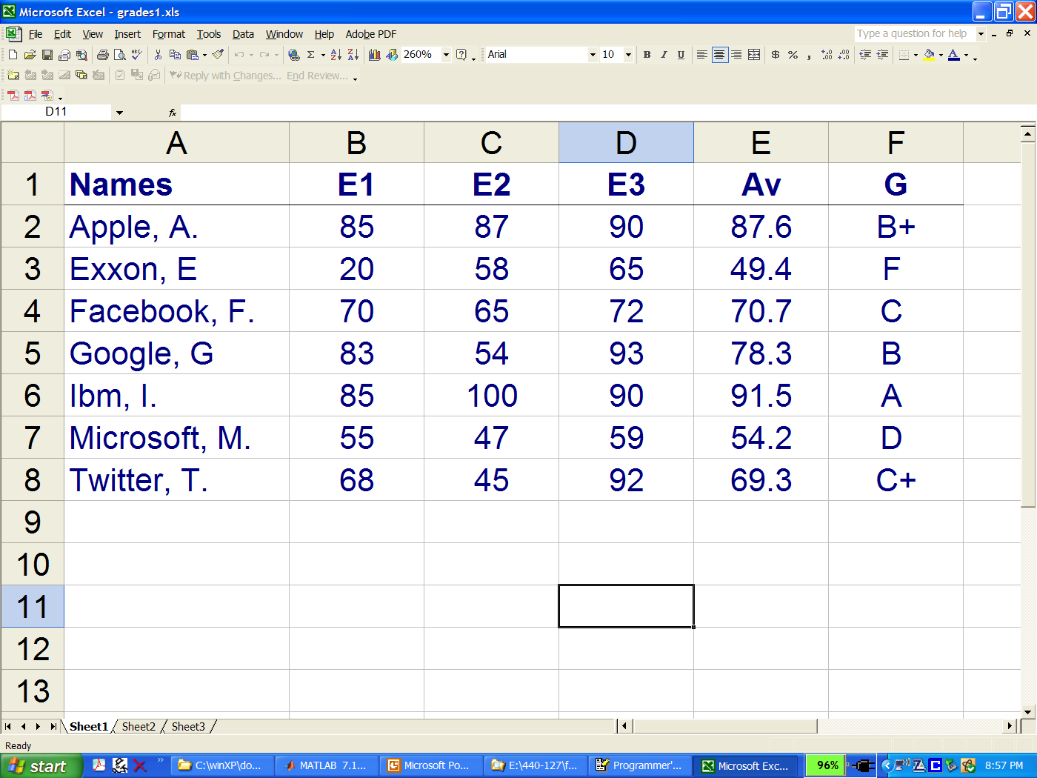
reading & writing excel files, xlsread, xlswrite

Slide 41
>> [A,C] = xlsread('grades1.xls')
A =
85.0000 87.0000 90.0000 87.6000
20.0000 58.0000 65.0000 49.4000
70.0000 65.0000 72.0000 70.7000
83.0000 54.0000 93.0000 78.3000
85.0000 100.0000 90.0000 91.5000
55.0000 47.0000 59.0000 54.2000
68.0000 45.0000 92.0000 69.3000
numerical
text
cells

Slide 42
C =
'Names' 'E1' 'E2' 'E3' 'Av' 'G'
'Apple, A.' '' '' '' '' 'B+'
'Exxon, E' '' '' '' '' 'F '
'Facebook, F.' '' '' '' '' 'C '
'Google, G' '' '' '' '' 'B '
'Ibm, I.' '' '' '' '' 'A '
'Microsoft, M.' '' '' '' '' 'D '
'Twitter, T.' '' '' '' '' 'C+'
>> xlswrite('grades2.xls',A);

Slide 43
Image Files
A = imread(filename, fmt);
[A, map] = imread(filename, fmt);
imwrite(A,filename,fmt);
imfinfo(filename);
fmt: 'jpg', 'jp2', 'tiff', 'png',
'gif', 'bmp', and others
these functions have additional input/output options

Slide 44
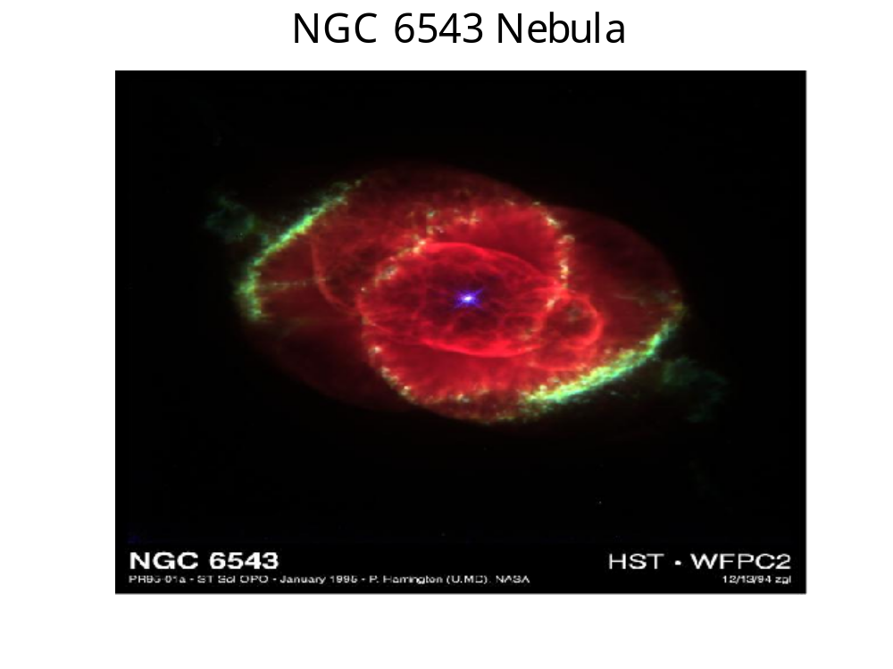
y = imread('ngc6543a.jpg', 'jpg');
image(y);
title('NGC 6543 Nebula'); axis off;

Slide 45
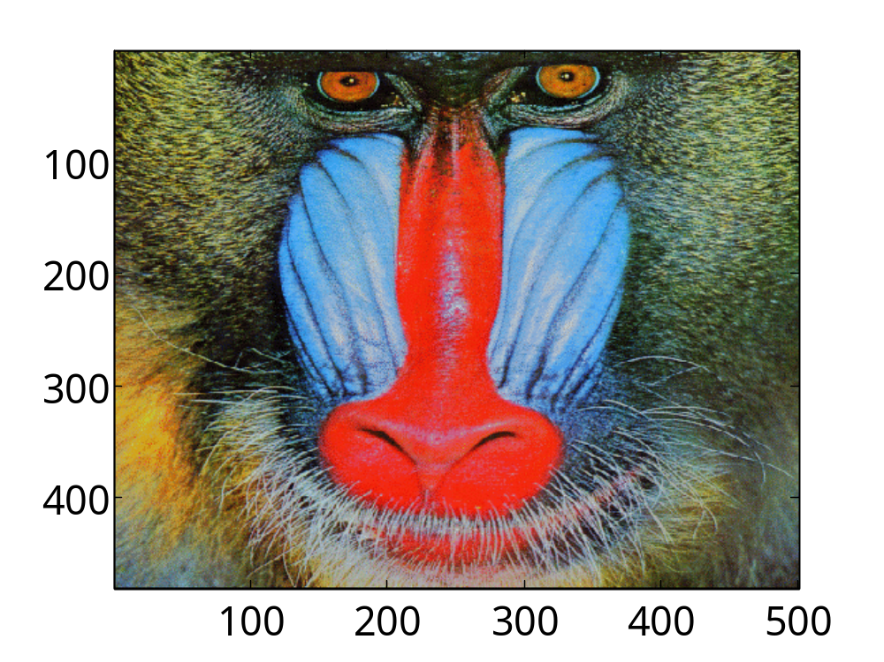
load mandrill; % MATLAB demo image
image(X); % X,map are part of the
colormap(map); % saved mandrill.mat file

Slide 46
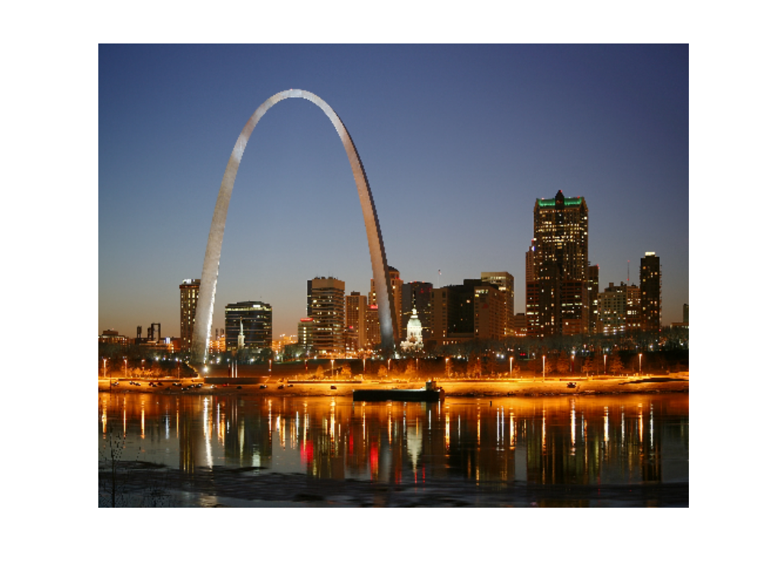
s1 = 'http://upload.wikimedia.org/';
s2 = 'wikipedia/commons/d/de/';
s3 = 'St_Louis_night_expblend.jpg';
filename = [s1,s2,s3];
y = imread(filename,'jpg');
image(y); axis off;
'http://upload.wikimedia.org/wikipedia/commons/d/de/St_Louis_night_expblend.jpg'

Slide 47
Reading, Writing, Recording, Playing Audio Files
[y,fs] = wavread(filename);
wavwrite(y,fs,filename);
y = wavrecord(n,fs); % n samples
y = wavrecord(N*fs,fs); % N seconds
sound(y,fs);
wavplay(y,fs);
% typical, fs = 8000, 11025, 22050, 44100
these functions have additional input/output options,
see week-2 lecture notes for some examples

Slide 48
Voice Scrambler Example
reads and plays a wave file
scrambles it by frequency inversion
implemented by AM modulation (at Nyquist)
plays the scrambled version
and saves it in a wave file
unscrambles it and plays it back

Slide 49
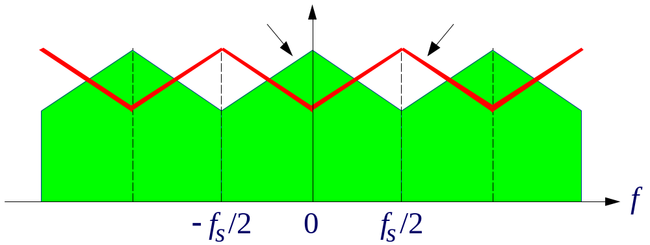

Voice Scrambler
frequency spectrum
of digitized signal
inverted spectrum

Slide 50
[x,fs] = wavread('JB.wav'); % read wave file
sound(x,fs); % play wave file
% here, fs=16000
n = (0:length(x)-1)'; % length(x)=71472
y = (-1).^n .* x; % scrambled signal
pause; sound(y,fs); % play scrambled file
wavwrite(y,fs, 'JBs.wav'); % write wave file
y = (-1).^n .* y; % unscramble
pause; sound(y,fs); % play unscrambled

Slide 51
Record and scramble/unscramble your own voice
Connect a mike at the microphone input of your PC,
execute the following MATLAB commands to
record your voice for 5 seconds at a sampling
rate of 16000 samples/sec, and save the recording
in a wavefile 'test.wav', then edit the previous
code segment to read this wave file, and run it.
fs = 16000;
y = wavrecord(5*fs, fs);
wavwrite(y,fs,'test.wav');
5*fs = number of samples in 5 sec

